Slide 1
A brief Introduction to
Foundation Design:
Design Principles

Slide 2
Unity and Variety

Slide 3
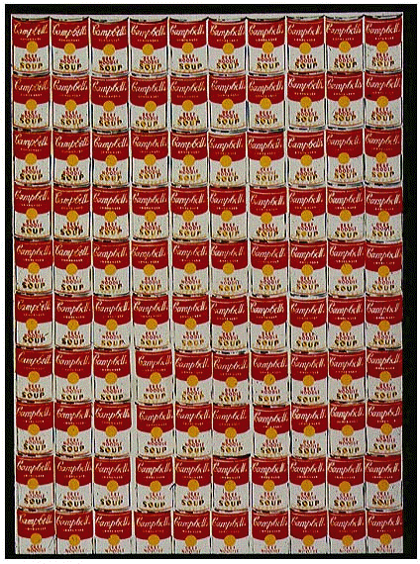
Warhol “100 Soup Cans” 1962

Slide 4
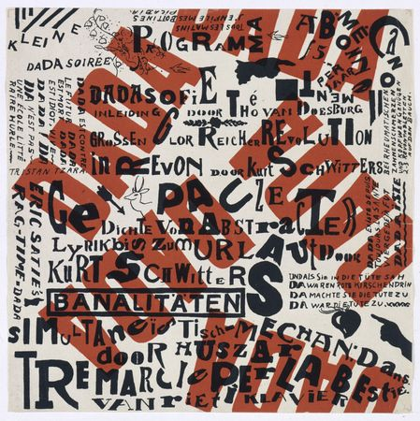
Schwitters “Dada Soiree” 1922

Slide 5
Repetition and Variation

Slide 6
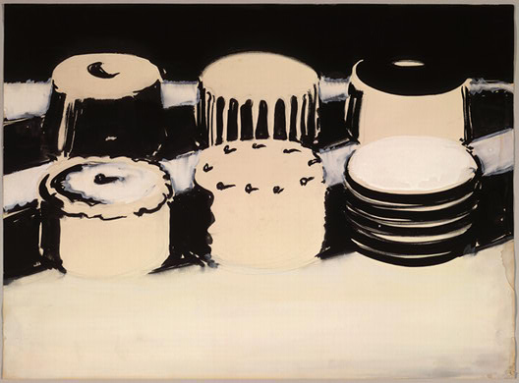
Thiebaud “Cake Study” 1963

Slide 7
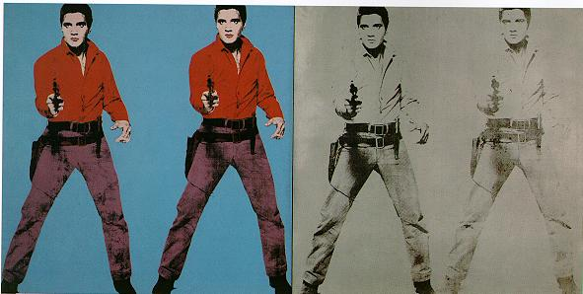
Warhol “Elvis” 1964

Slide 8
Emphasis

Slide 9
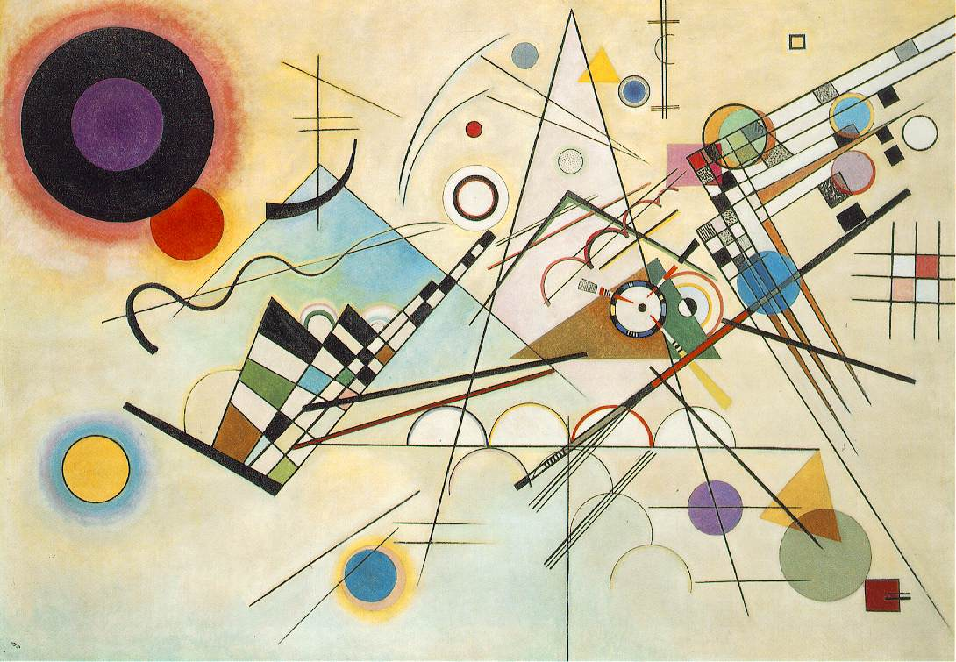
Kandinsky “Composition VIII” 1928

Slide 10
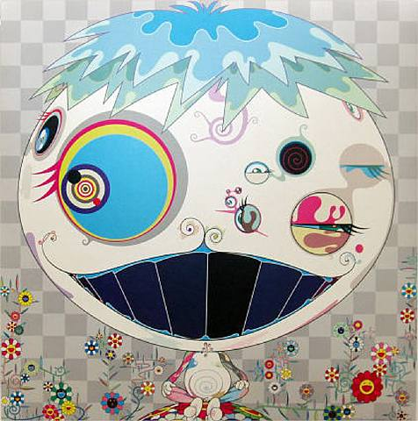
Murakami “Jerry Fish” 2003

Slide 11
Balance

Slide 12
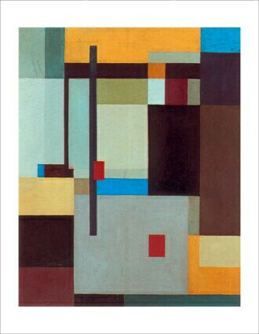
Schwitters “Konstructives”

Slide 13
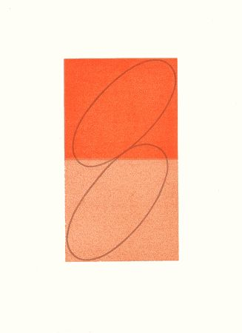
Mangold “Composition” c. 1995

Slide 14
Tension

Slide 15
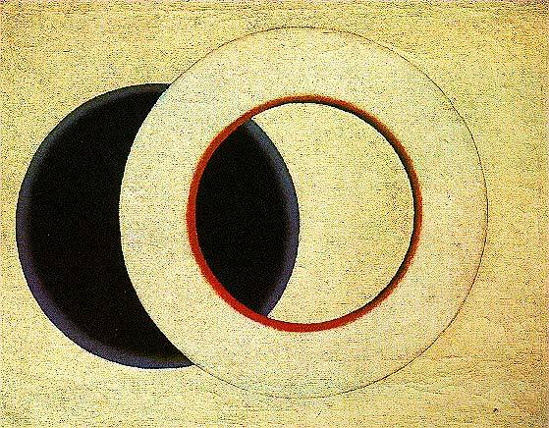
Rodchenko “Circles”

Slide 16
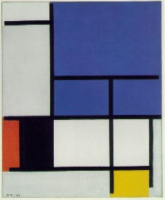
Mondrian “Blue Plane” 1921

Slide 17
Rhythm

Slide 18
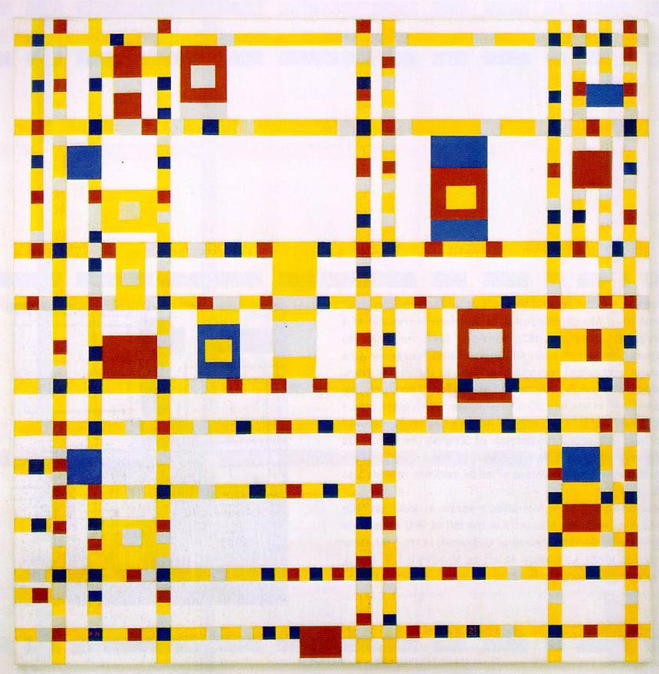
Mondrian “Broadway Boogie Woogie” 1943

Slide 19
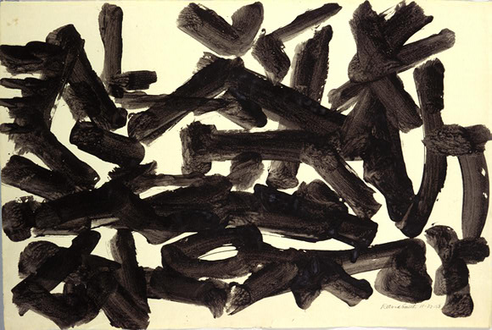
Smith, David “Untitled”

Slide 20
Scale

Slide 21
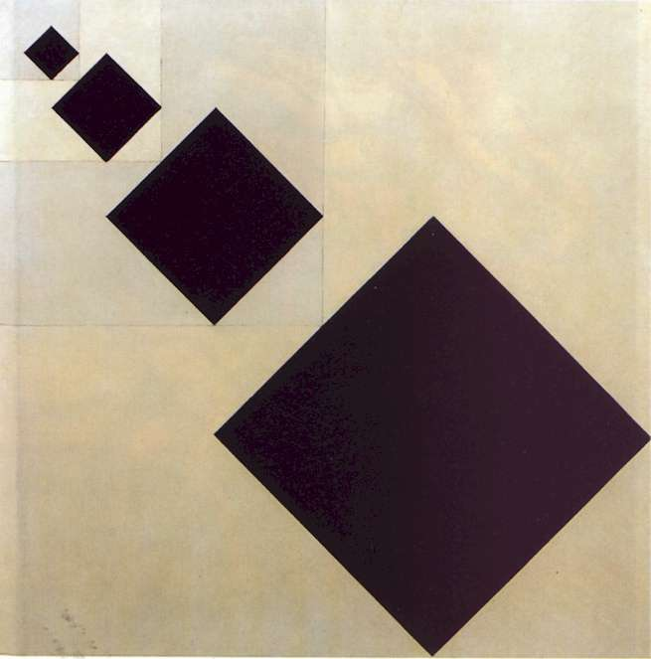
Van Doesburg “Squares”

Slide 22
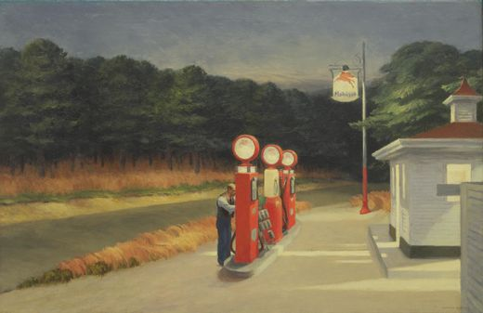
Hopper “Gas” 1940

Slide 23
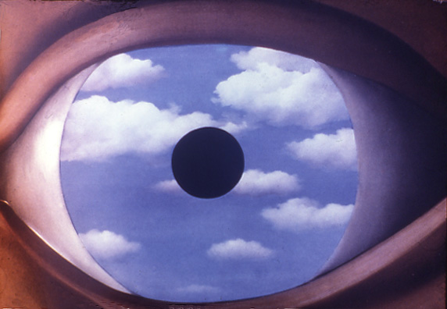
Magritte “The False Mirror” 1928

Slide 24
Proportion

Slide 25
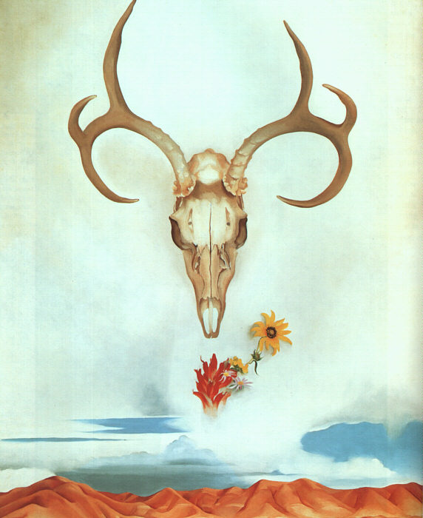
O’Keeffe “Desert Flowers” 1935

Slide 26
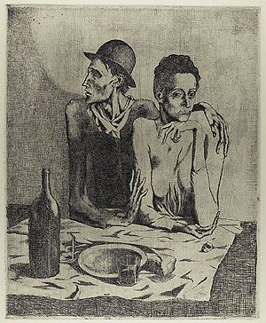
Picasso “The Frugal Meal” 1904

Slide 27
Negative Space

Slide 28
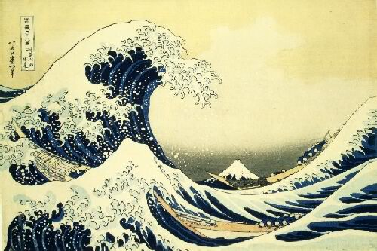
Hokusai “The Great Wave” 1830

Slide 29
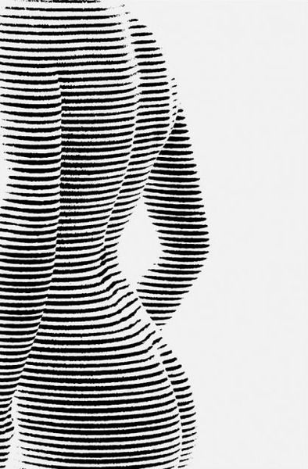

Slide 30
Movement

Slide 31
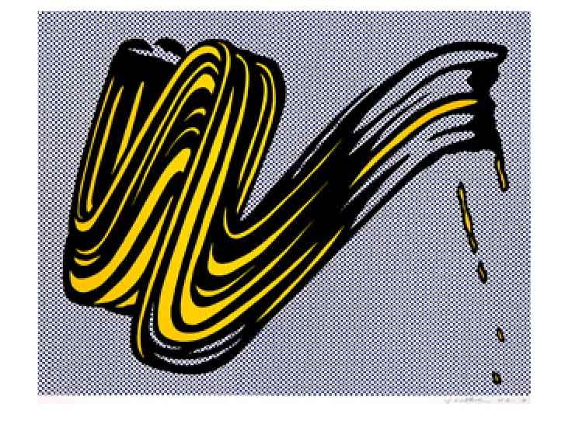
Lichtenstein “Brush Stroke” 1965

Slide 32
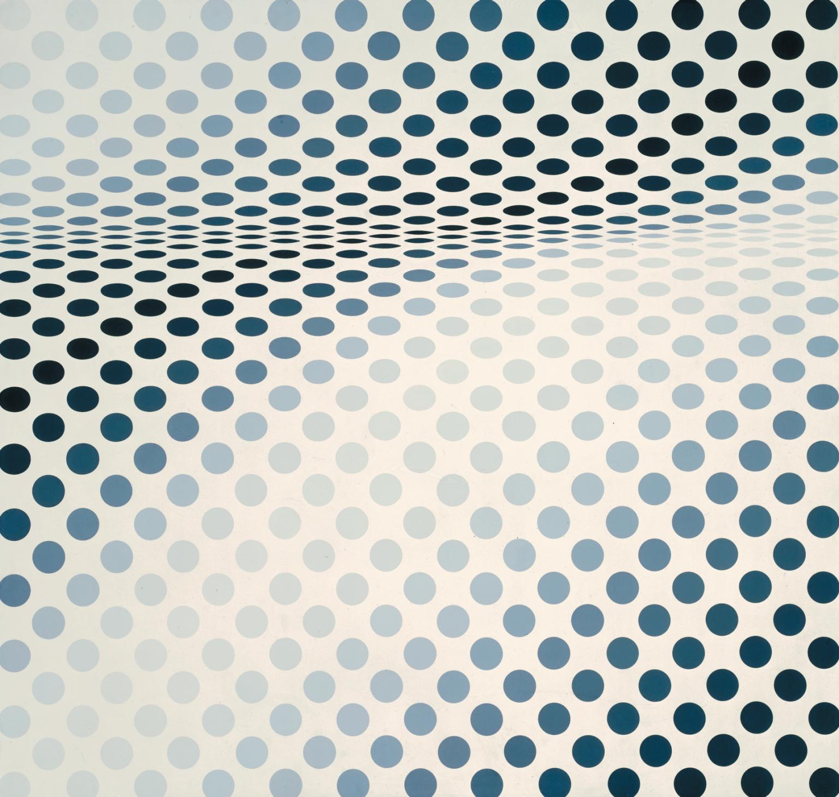
Hopper “Early Sunday Morning”

Slide 33
Figure/Ground
(Gestalt Theory)

Slide 34

Gestalt: Vase or Facial Profiles?

Slide 35
