Slide 1
24 Thumbnails: Letter Composition

Slide 2
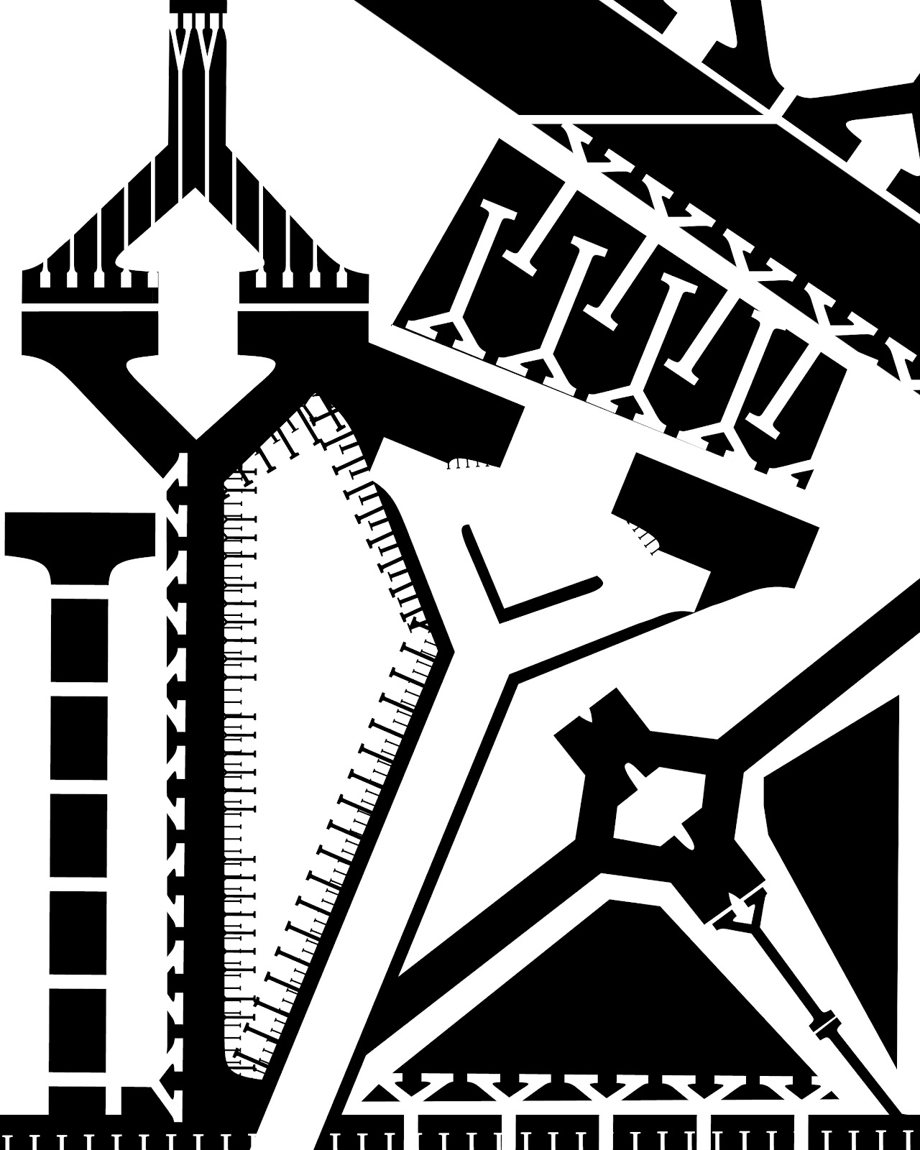
Repetition, overlapping, scale changes, cropping

Slide 3

Overlapping, cropping

Slide 4

Repetition, overlapping, scale changes, cropping

Slide 5

Repetition, overlapping, scale changes, cropping

Slide 6

Repetition, overlapping, scale changes, cropping

Slide 7

Repetition, overlapping, scale changes, cropping

Slide 8
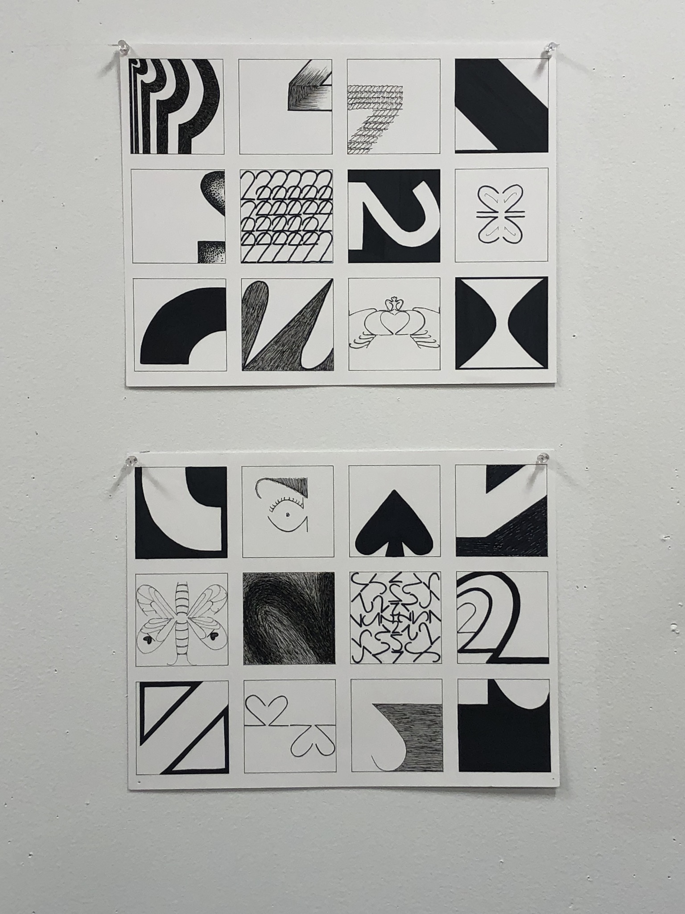
Repetition, overlapping, scale changes, cropping

Slide 9
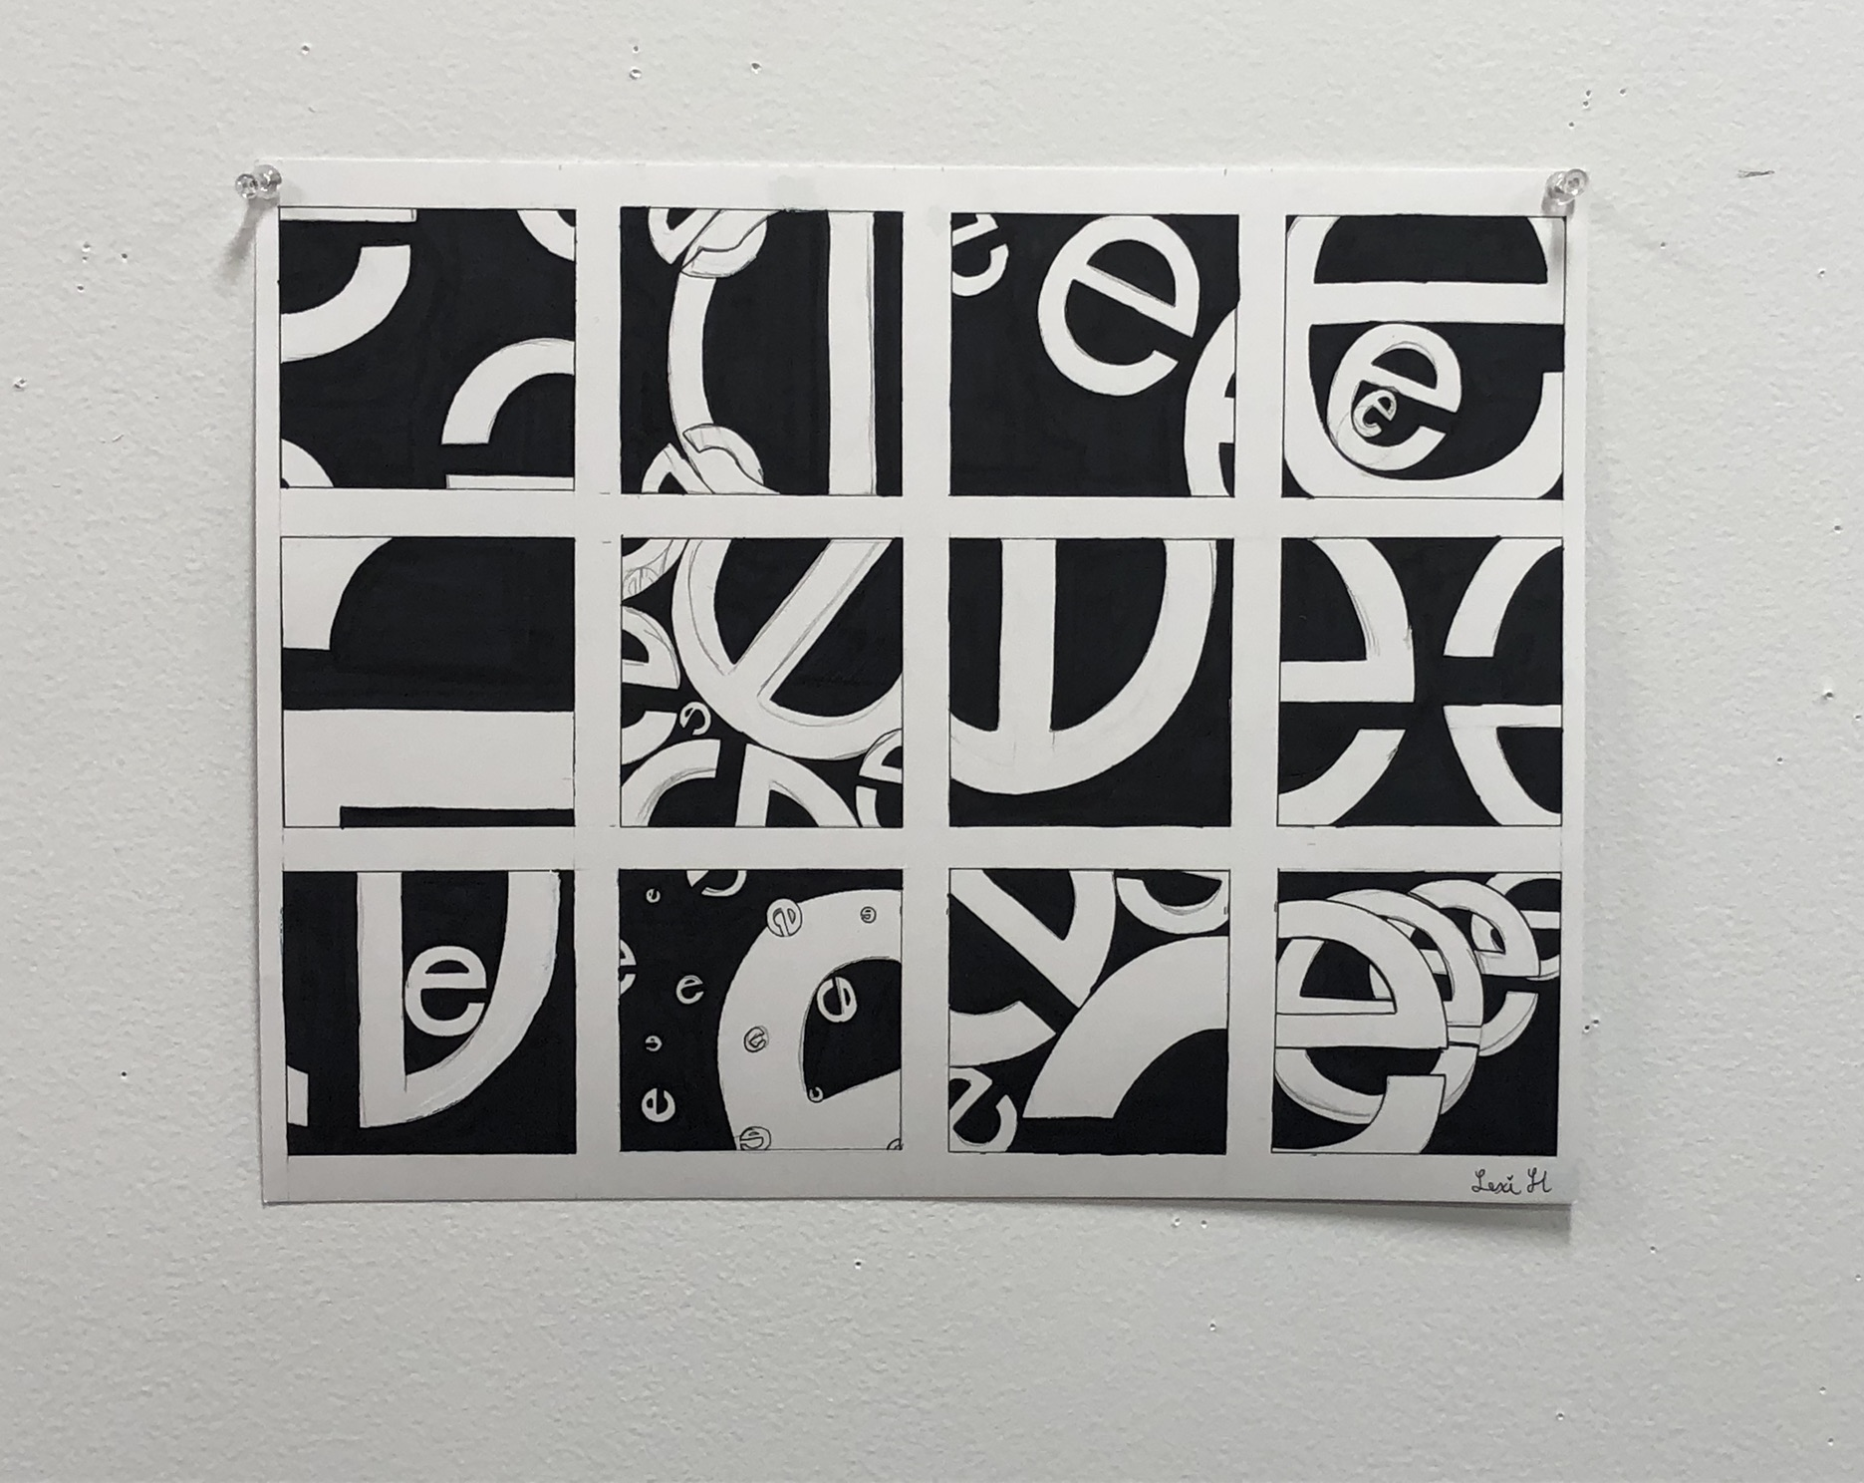
Repetition, overlapping, scale changes, cropping

Slide 10
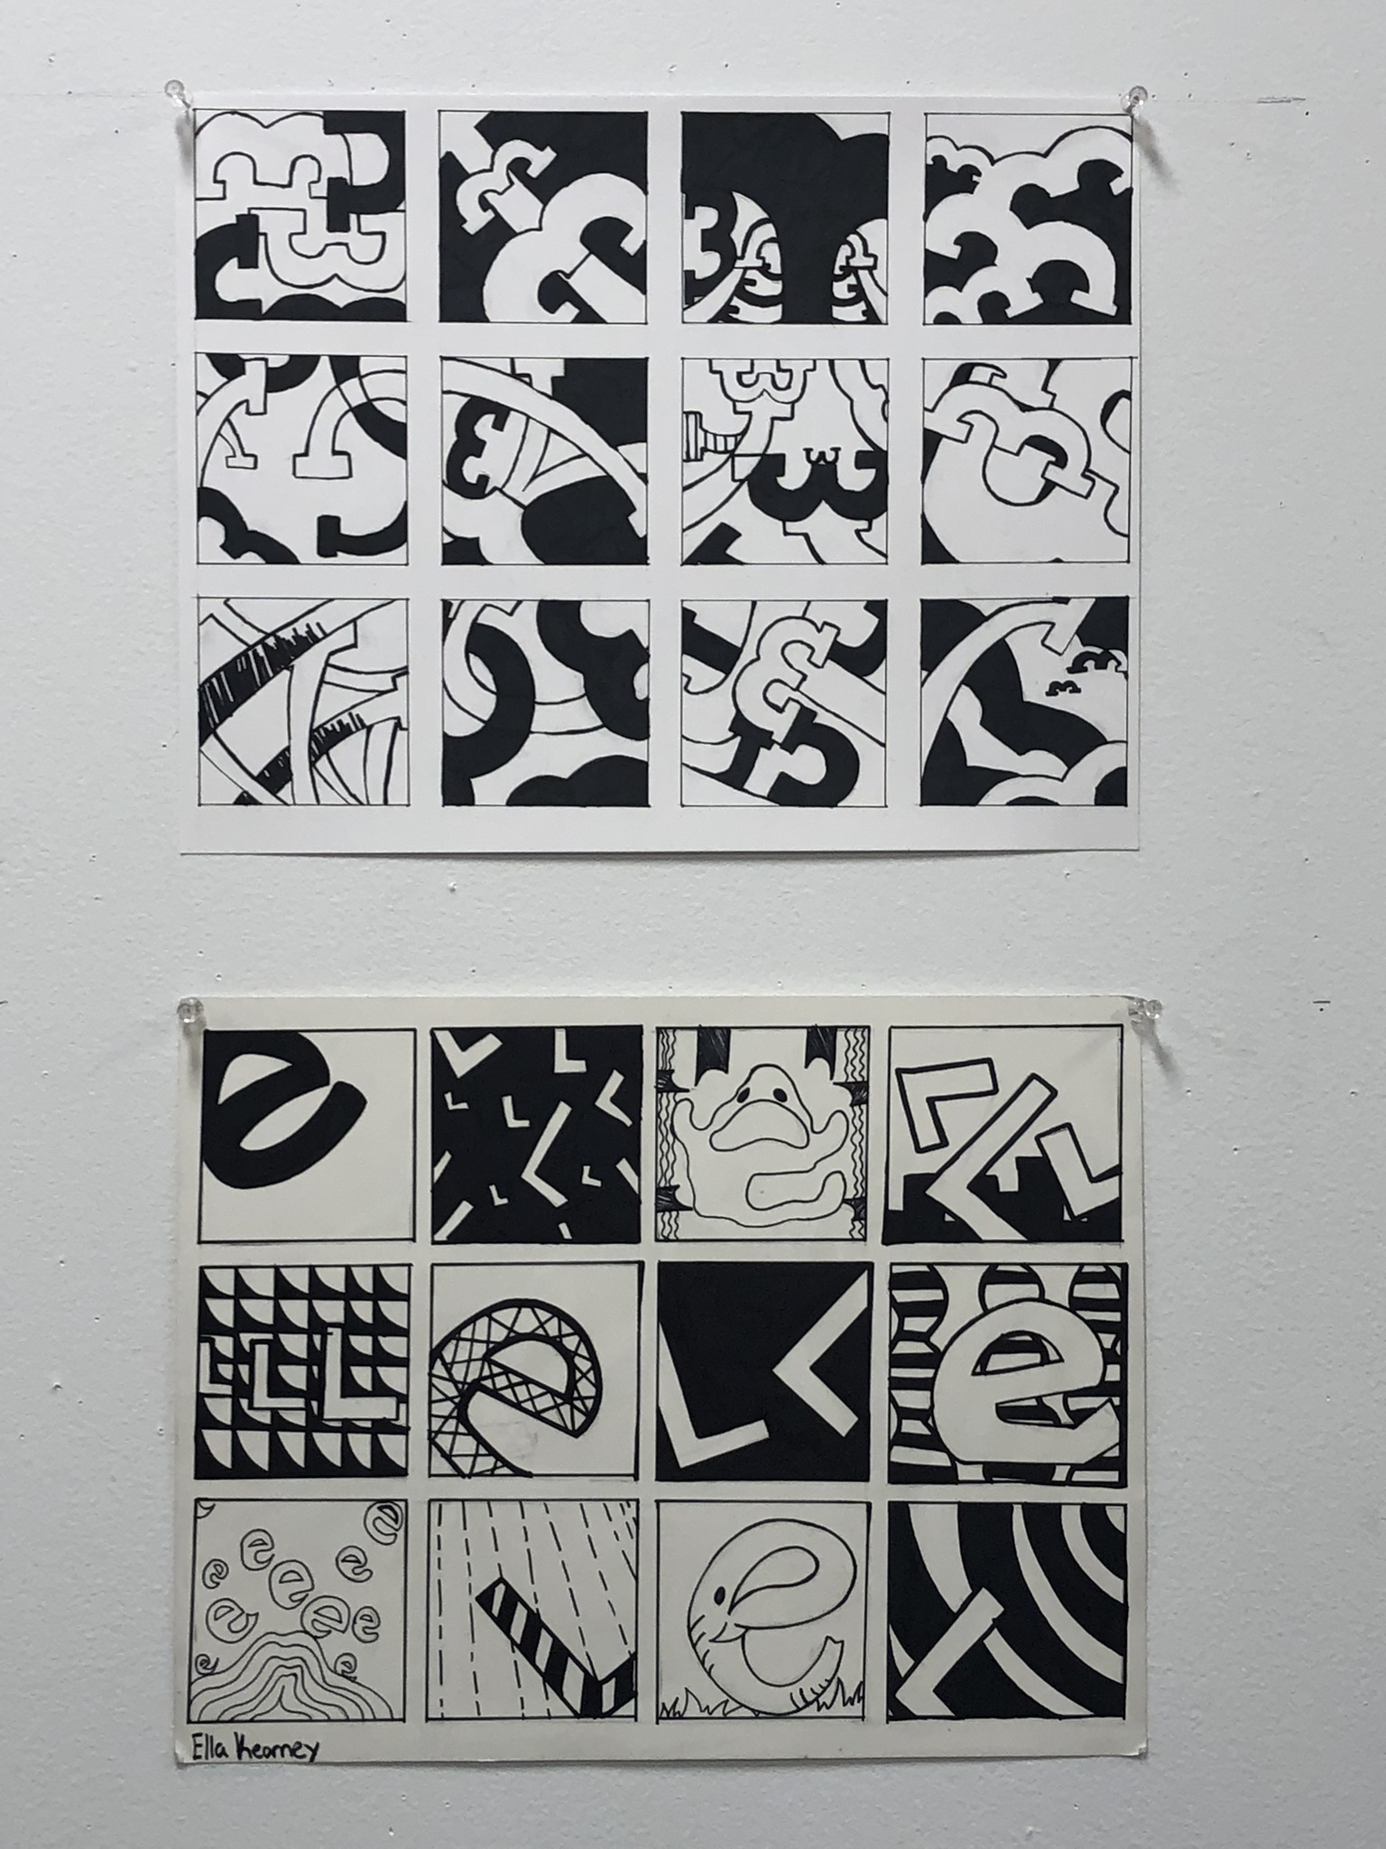
Repetition, overlapping, scale changes, cropping

Slide 11
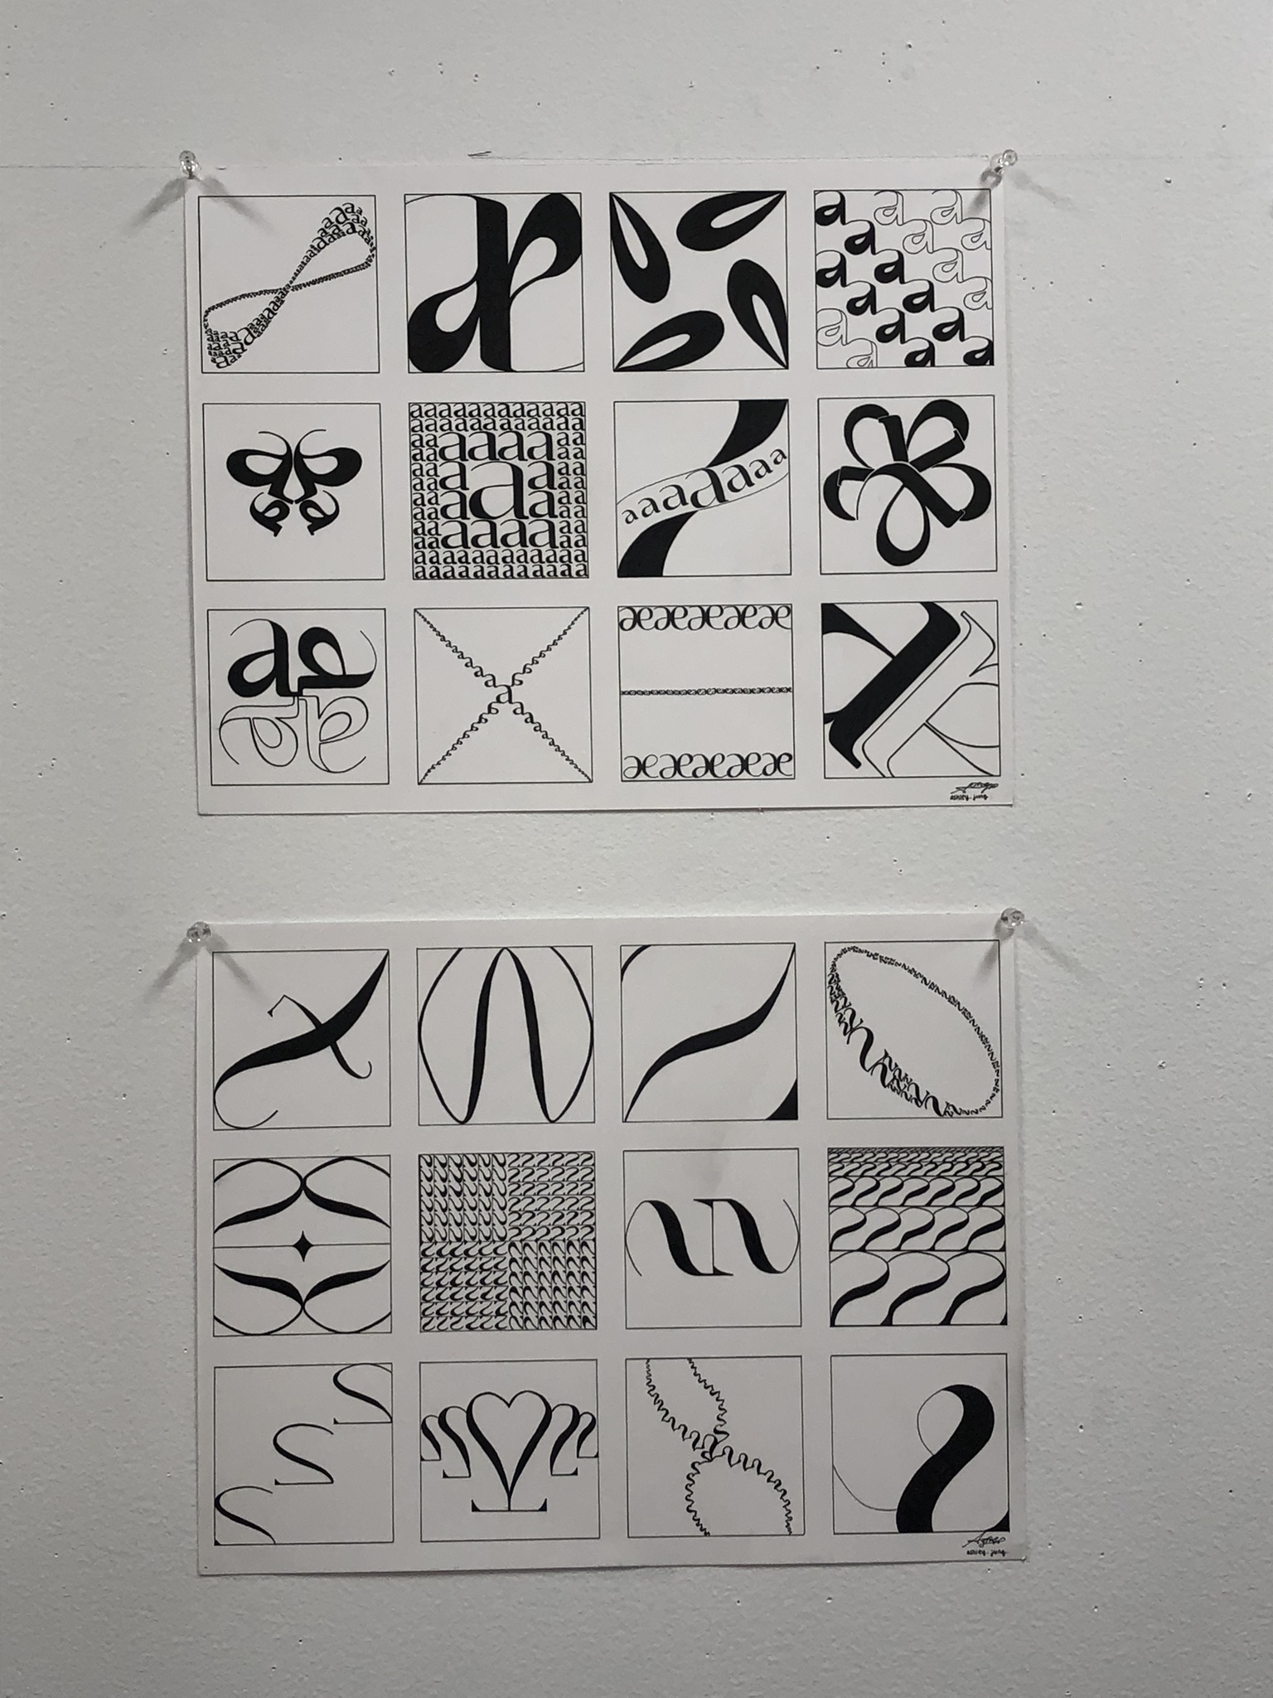
Repetition, overlapping, scale changes, cropping

Slide 12
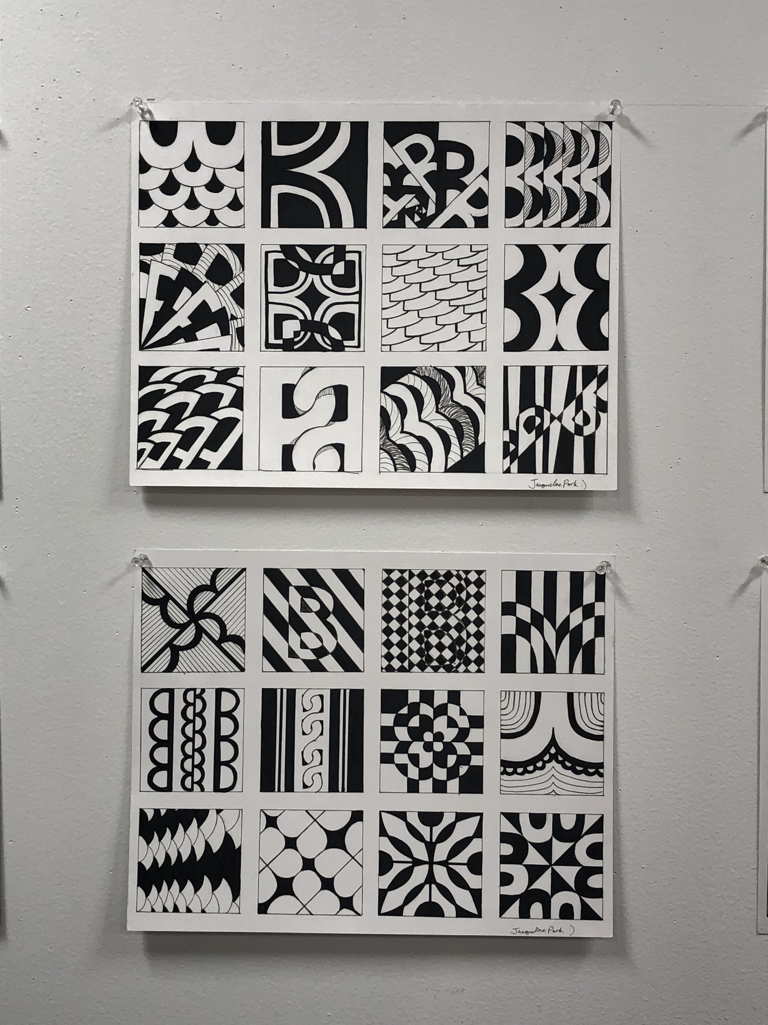
Repetition, overlapping, scale changes, cropping

Slide 13
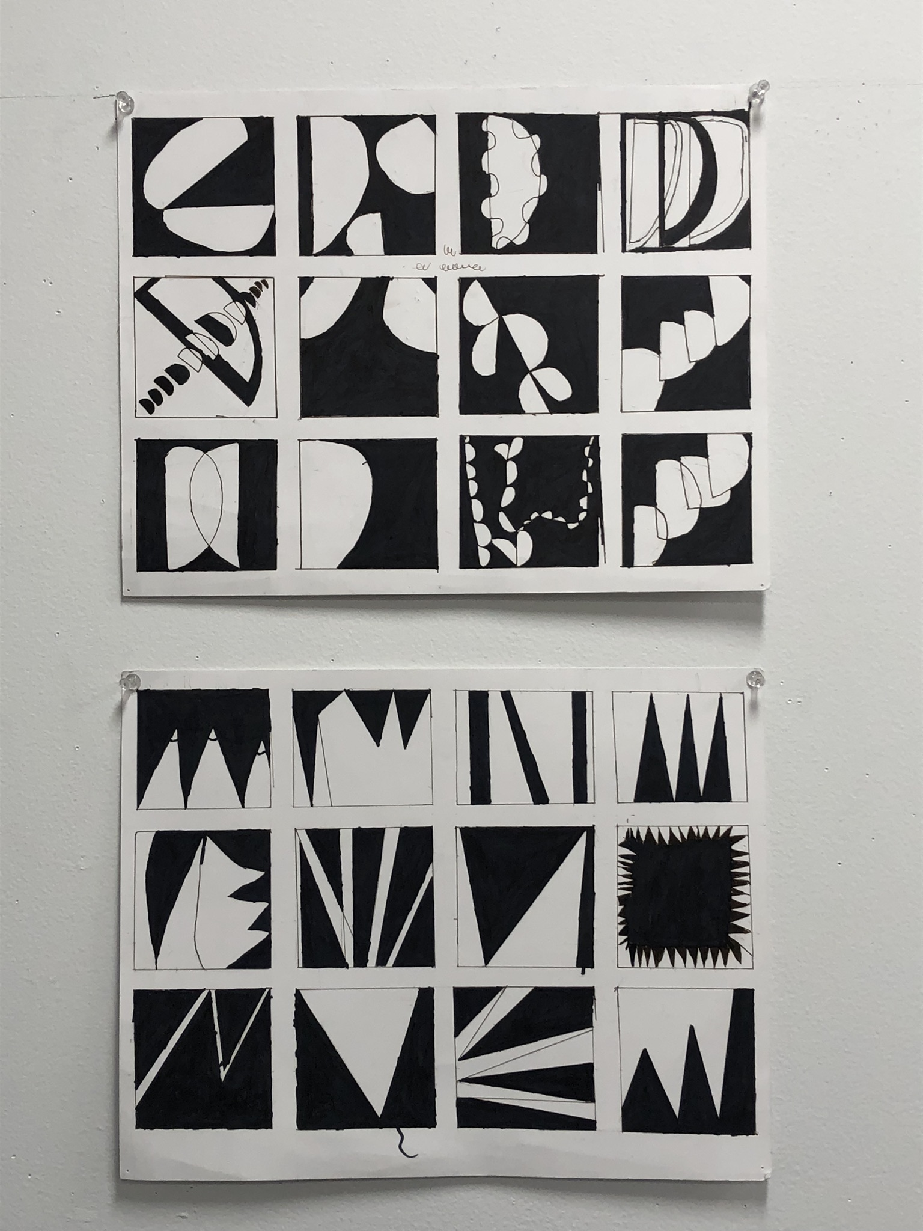
Repetition, overlapping, scale changes, cropping

Slide 14
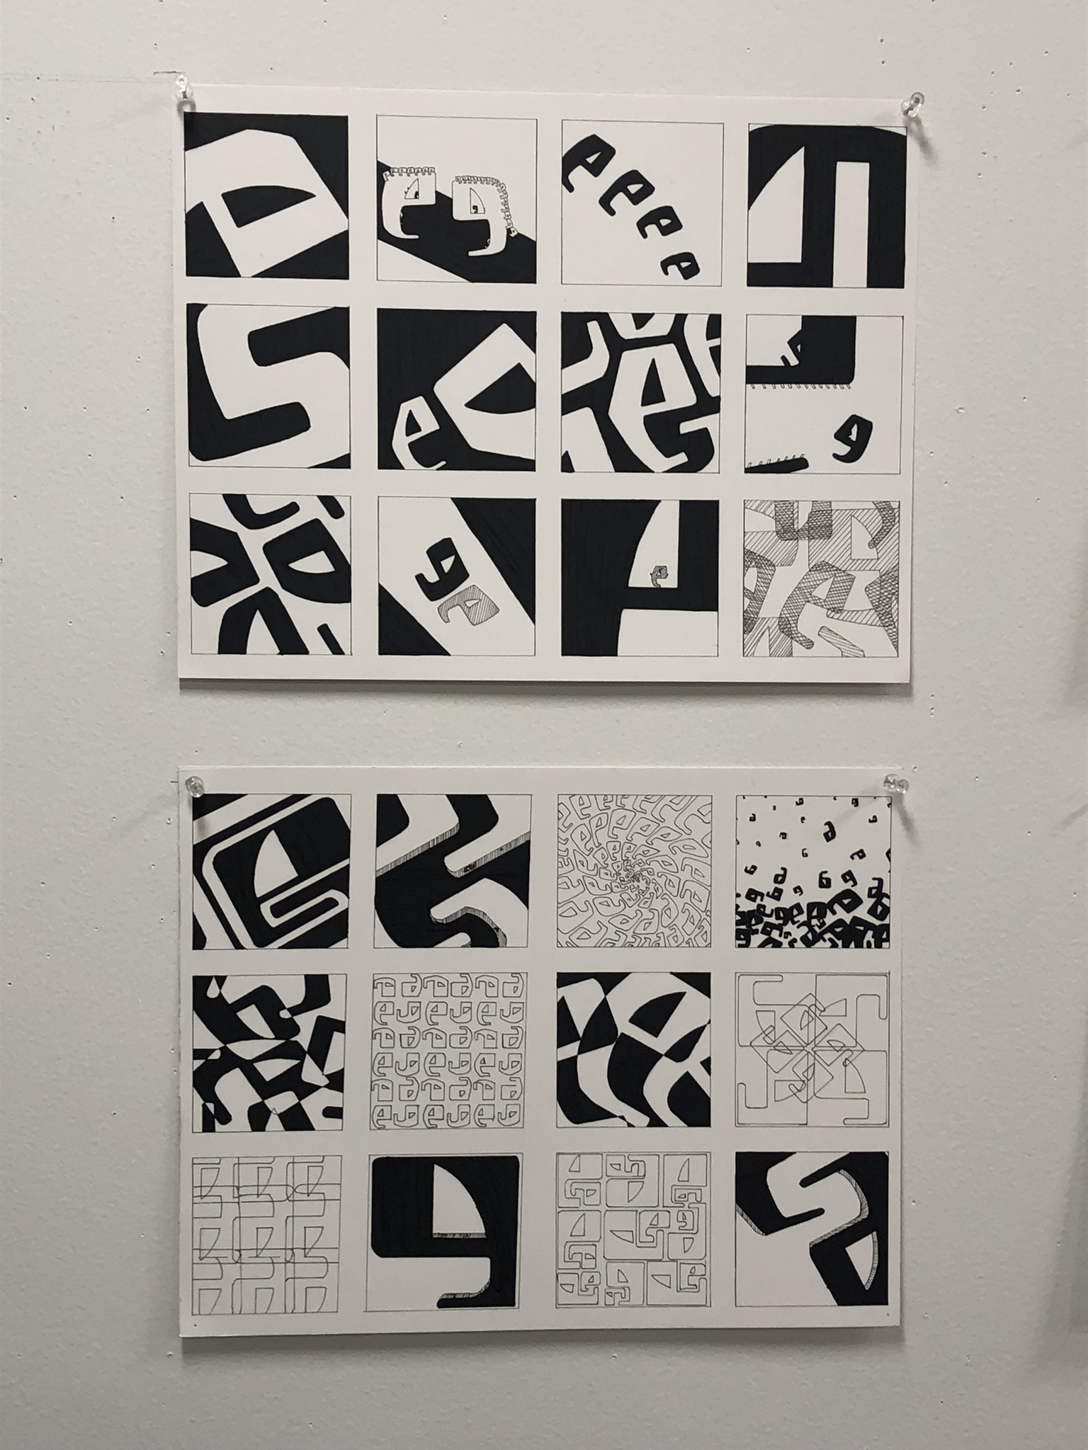
Repetition, overlapping, scale changes, cropping

