Slide 1
Multiple Viewpoints:
Spatial Shifts, Dynamic Movement, Transparency
Art Historical Muse: Analytic Cubism, Futurism
Artists Viewed: Popova, Goncharova, Picasso, Gris, Duchamp, Boccioni, Balla

Slide 2
New Technology
New Perceptions
Photography
The Movie Camera
Locomotive
Electricity
Radio

Slide 3
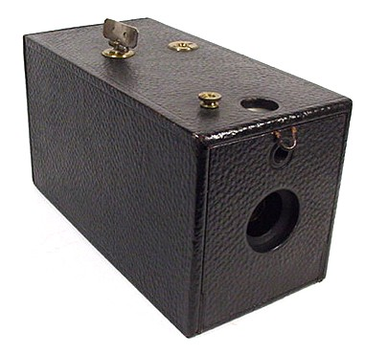
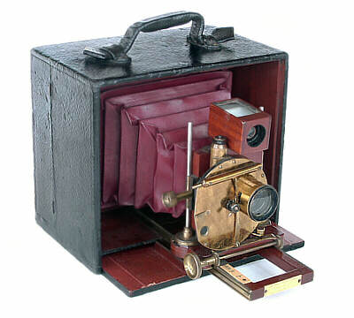
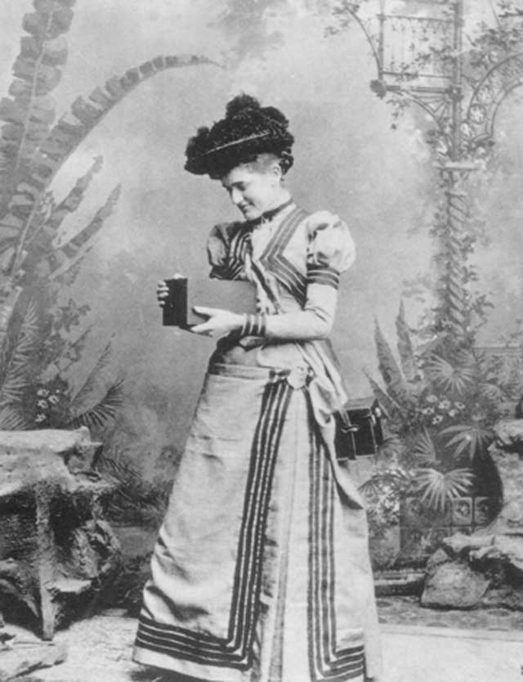
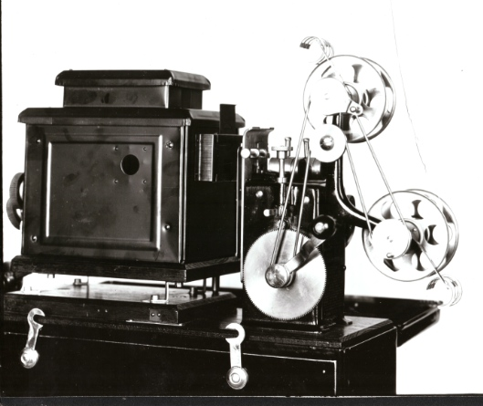
Contextual Factors
Technical Influences: the camera and movie camera
How might these affect artistic perception and production?
⬅ Eastman’s Camera 1888
(with roll film) ⬇
Notes:
3

Slide 4
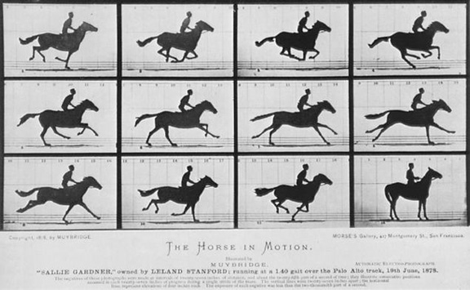
Muybridge “Horses”

Slide 5
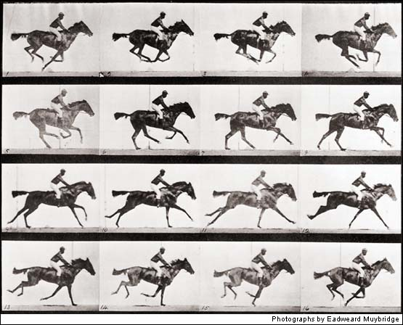
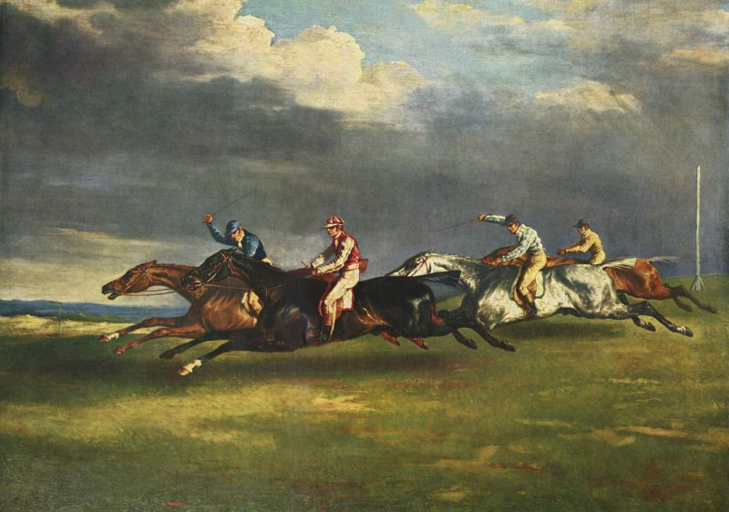
Muybridge “Study of Horses”1881 Gericault “The Epsom Derby”1823

Slide 6
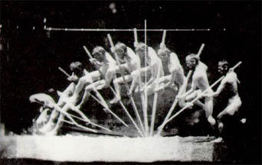
Eakins “Pole Vaulter” 1880’s

Slide 7
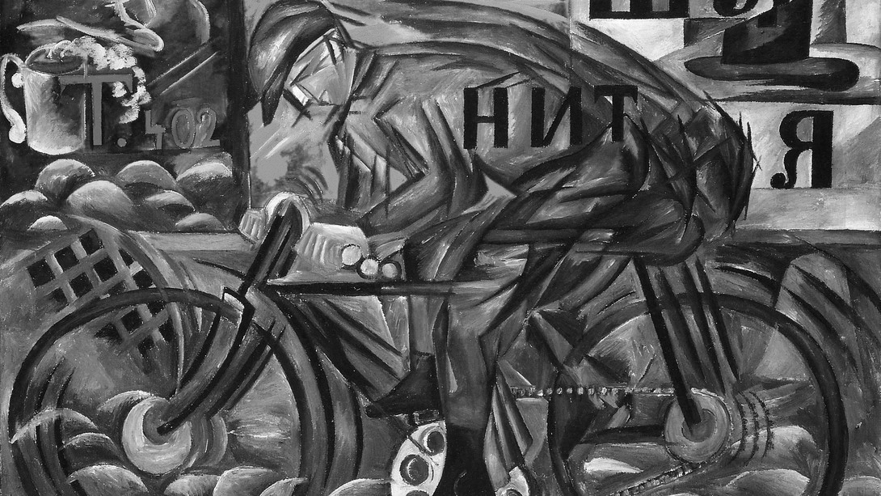
Natalia Goncharova, “Cyclist”

Slide 8
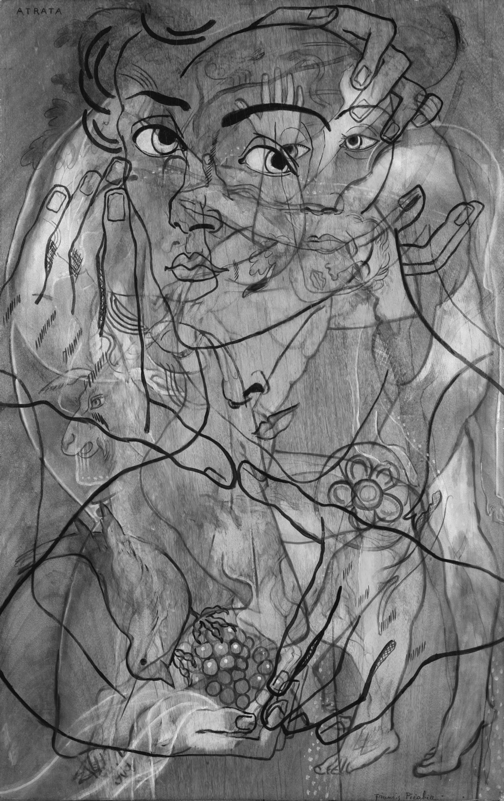

Slide 9
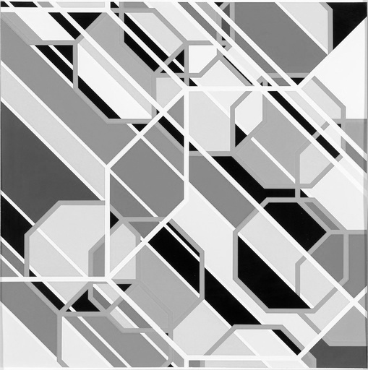
Sarah Morris (B&W version), Los Angeles

Slide 10
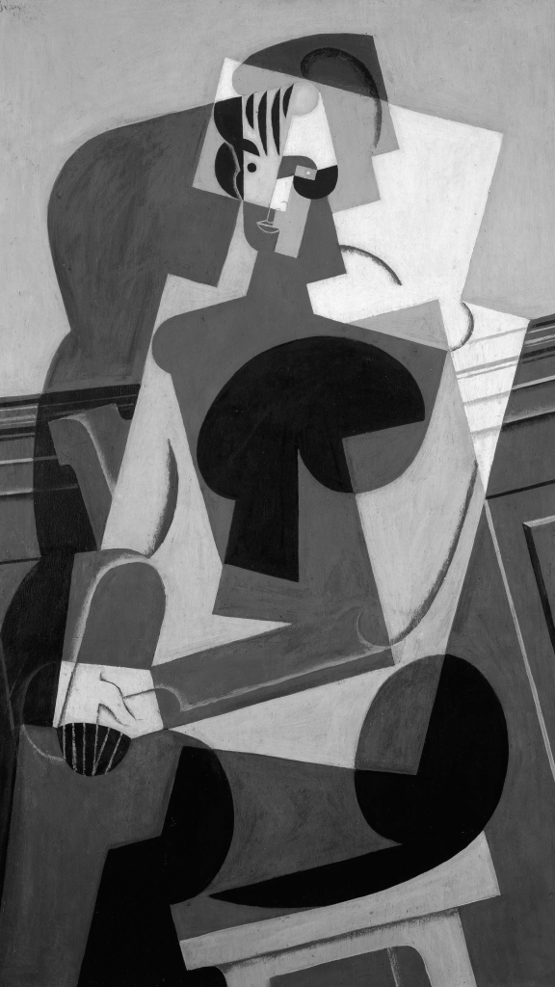
Gris, Portrait of Josette

Slide 11
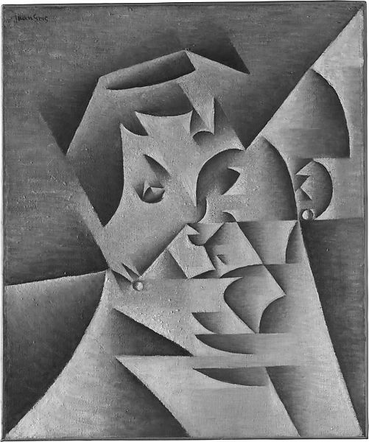
Juan Gris, “Head of a Woman”

Slide 12
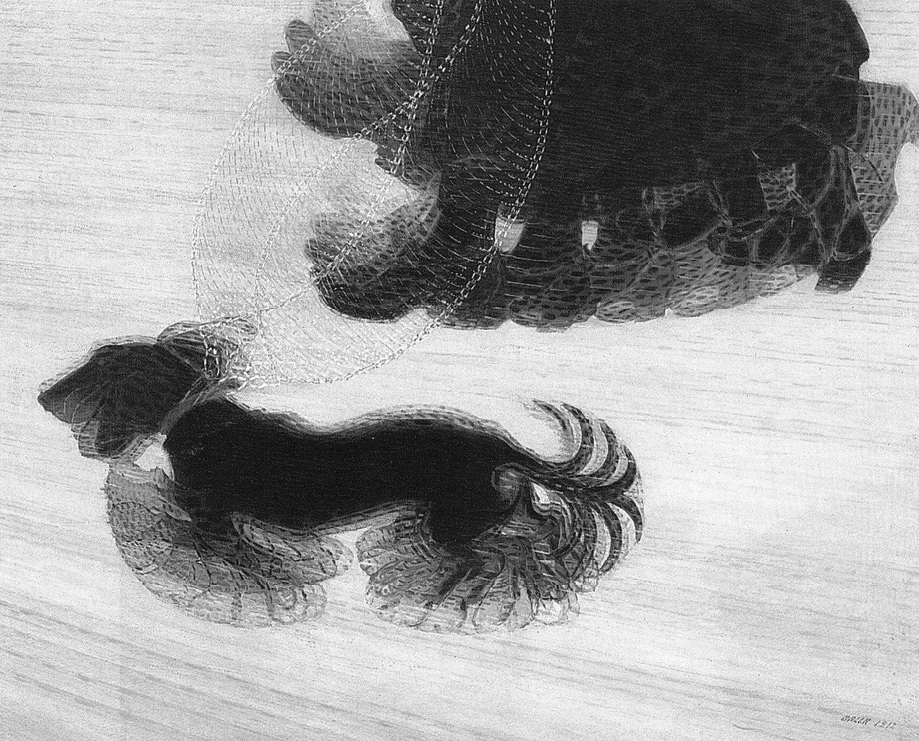
Balla, “Dynamism of a Dog Walking”

Slide 13
Student work:

Slide 14
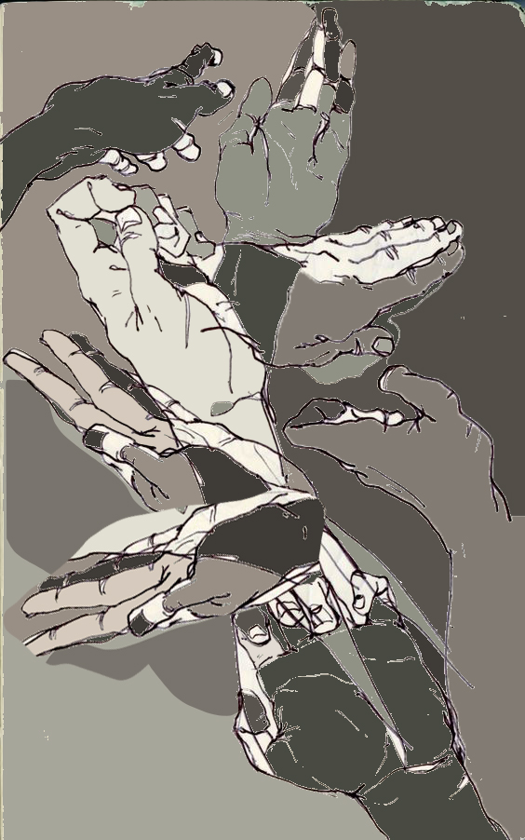

Slide 15
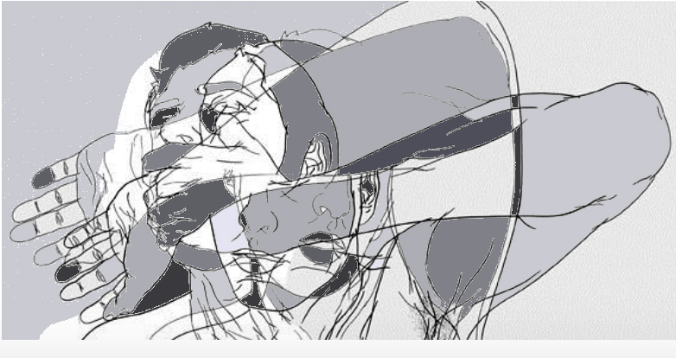

Slide 16
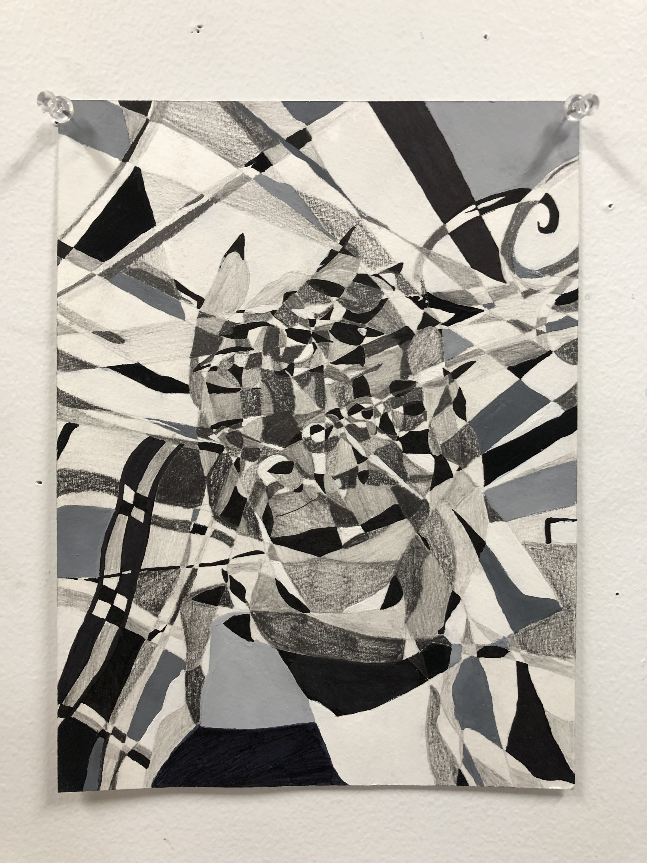

Slide 17
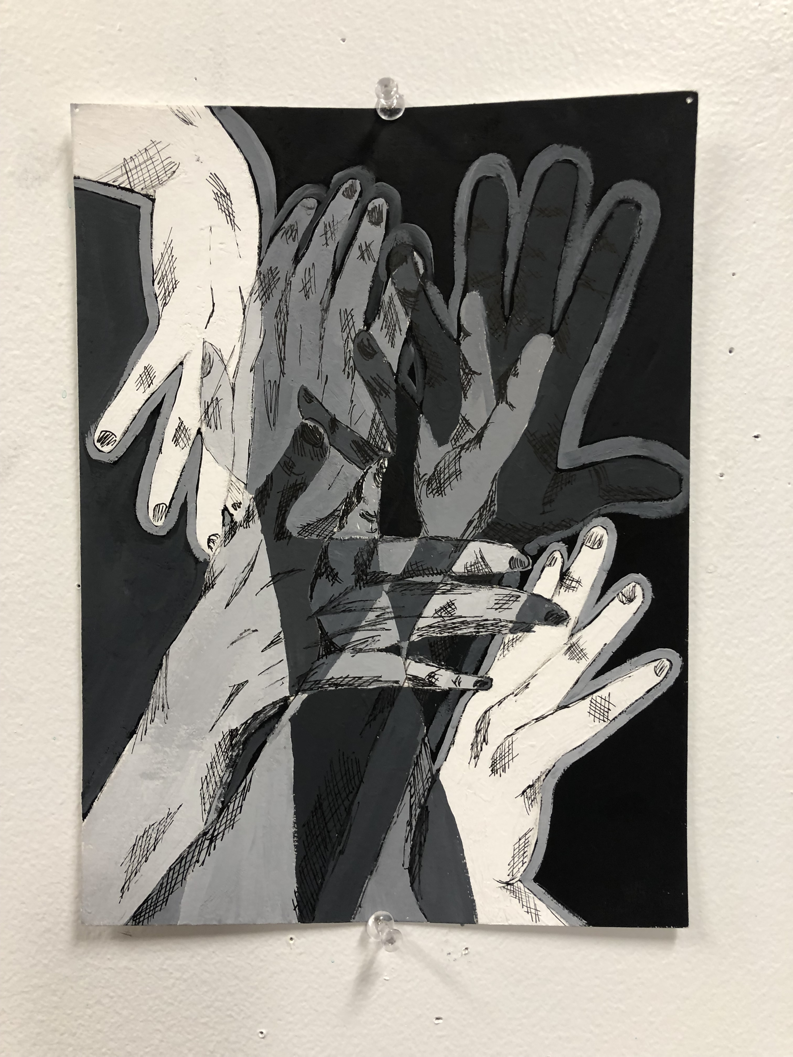

Slide 18
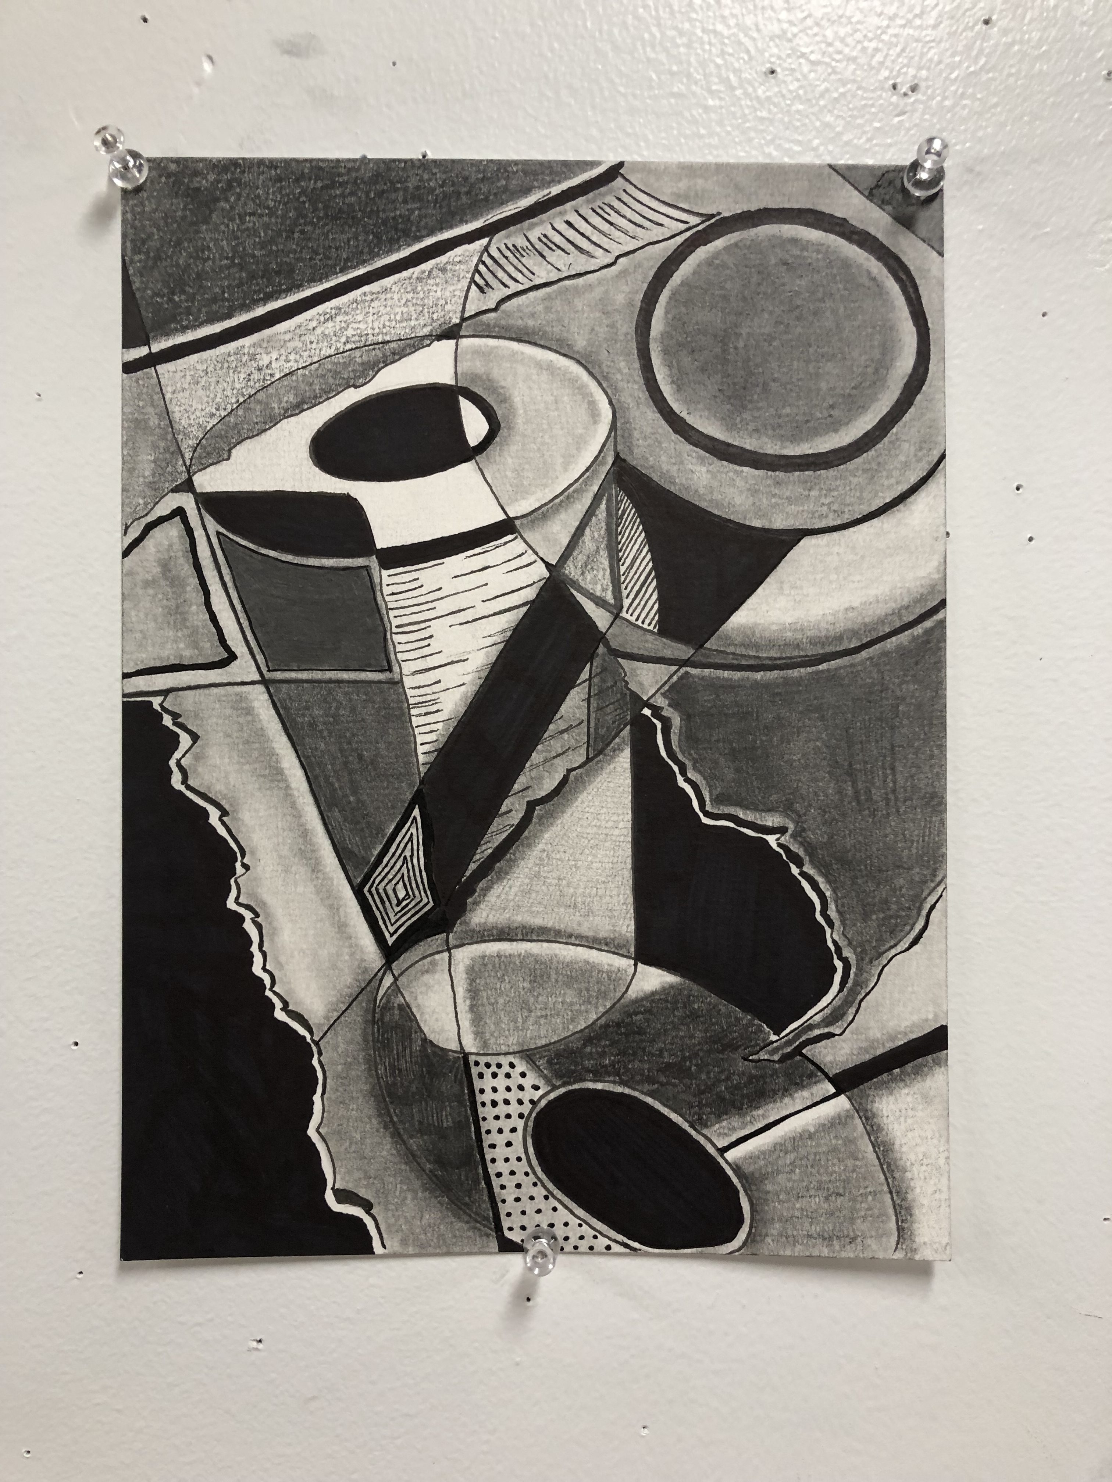

Slide 19
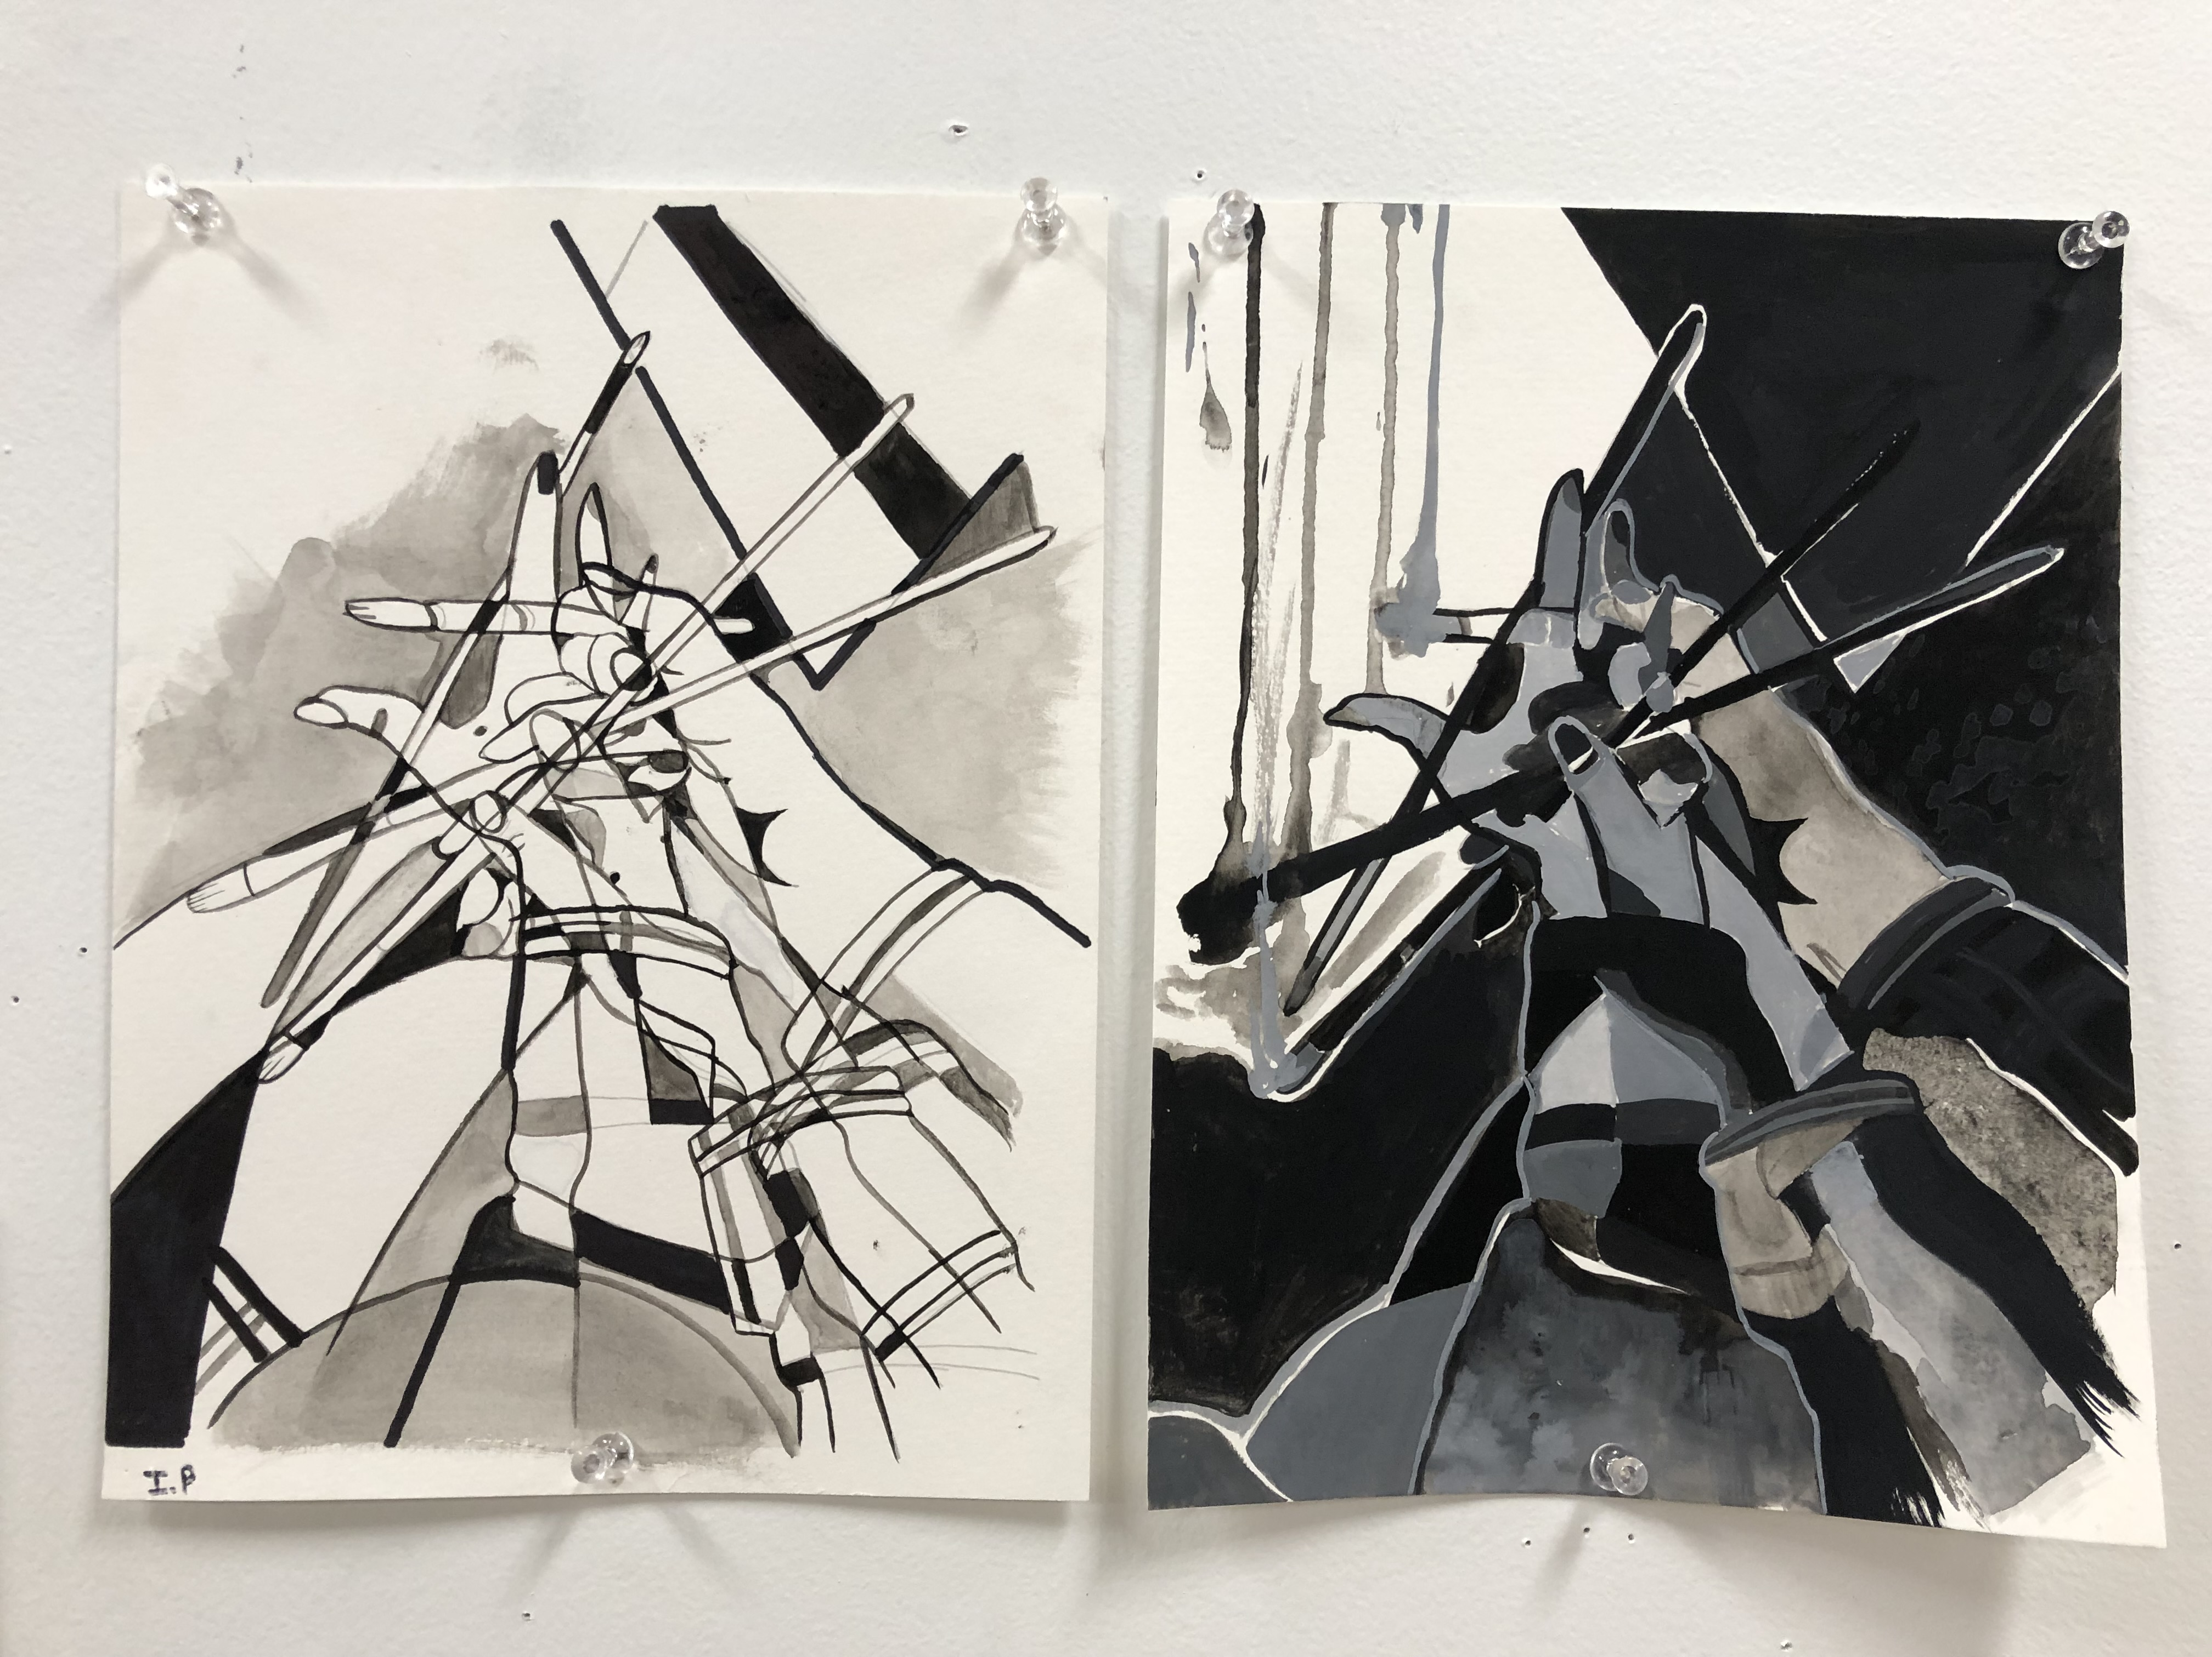

Slide 20
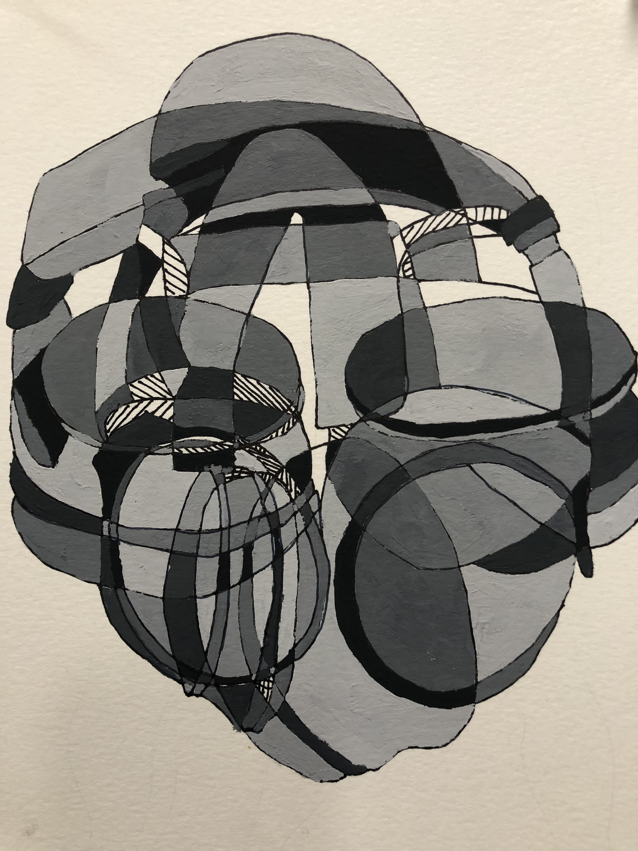

Slide 21
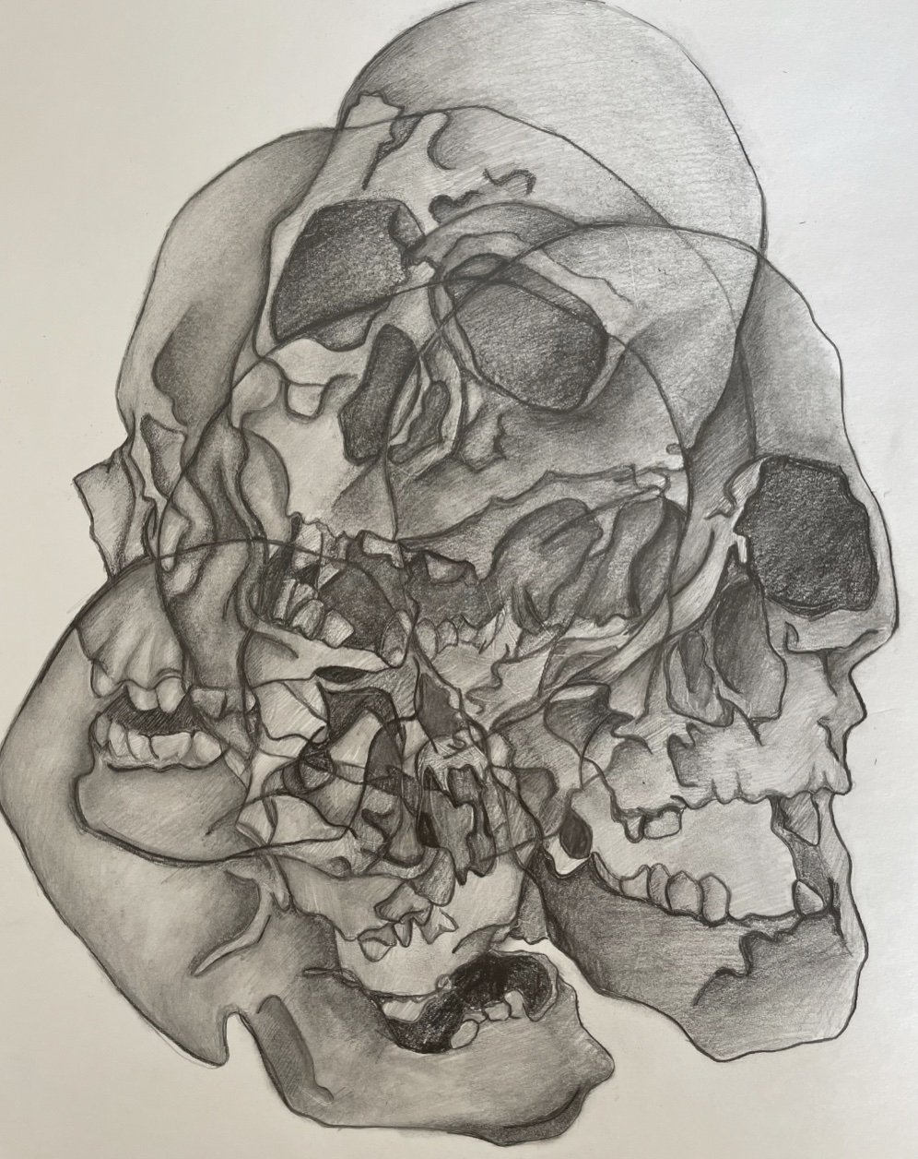

Slide 22
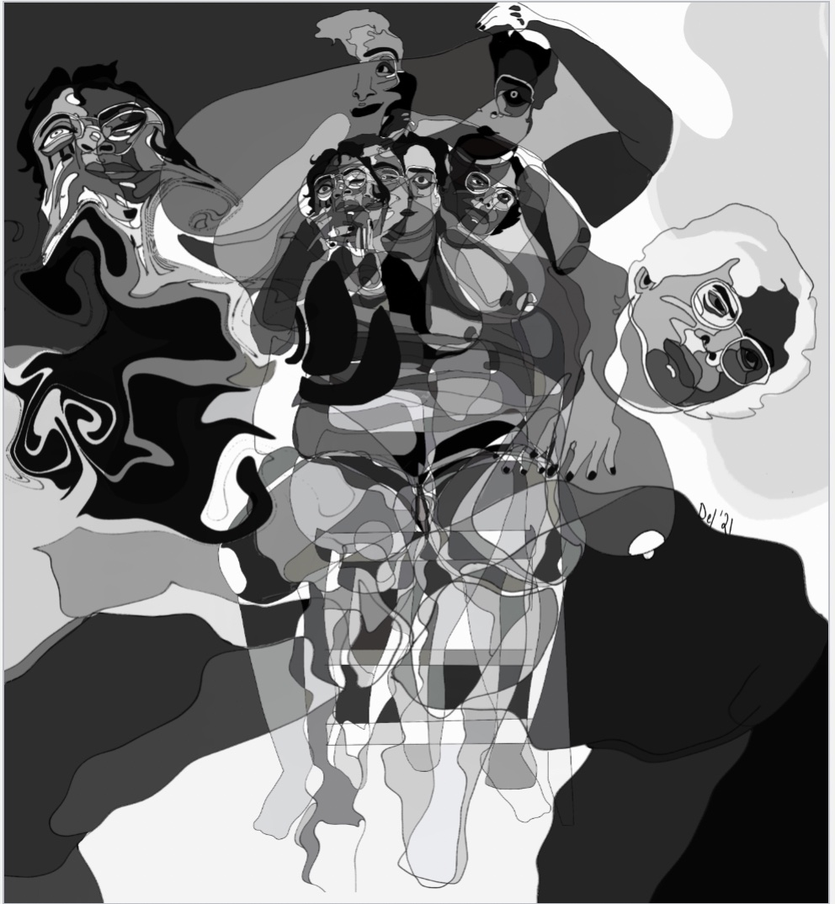

Slide 23
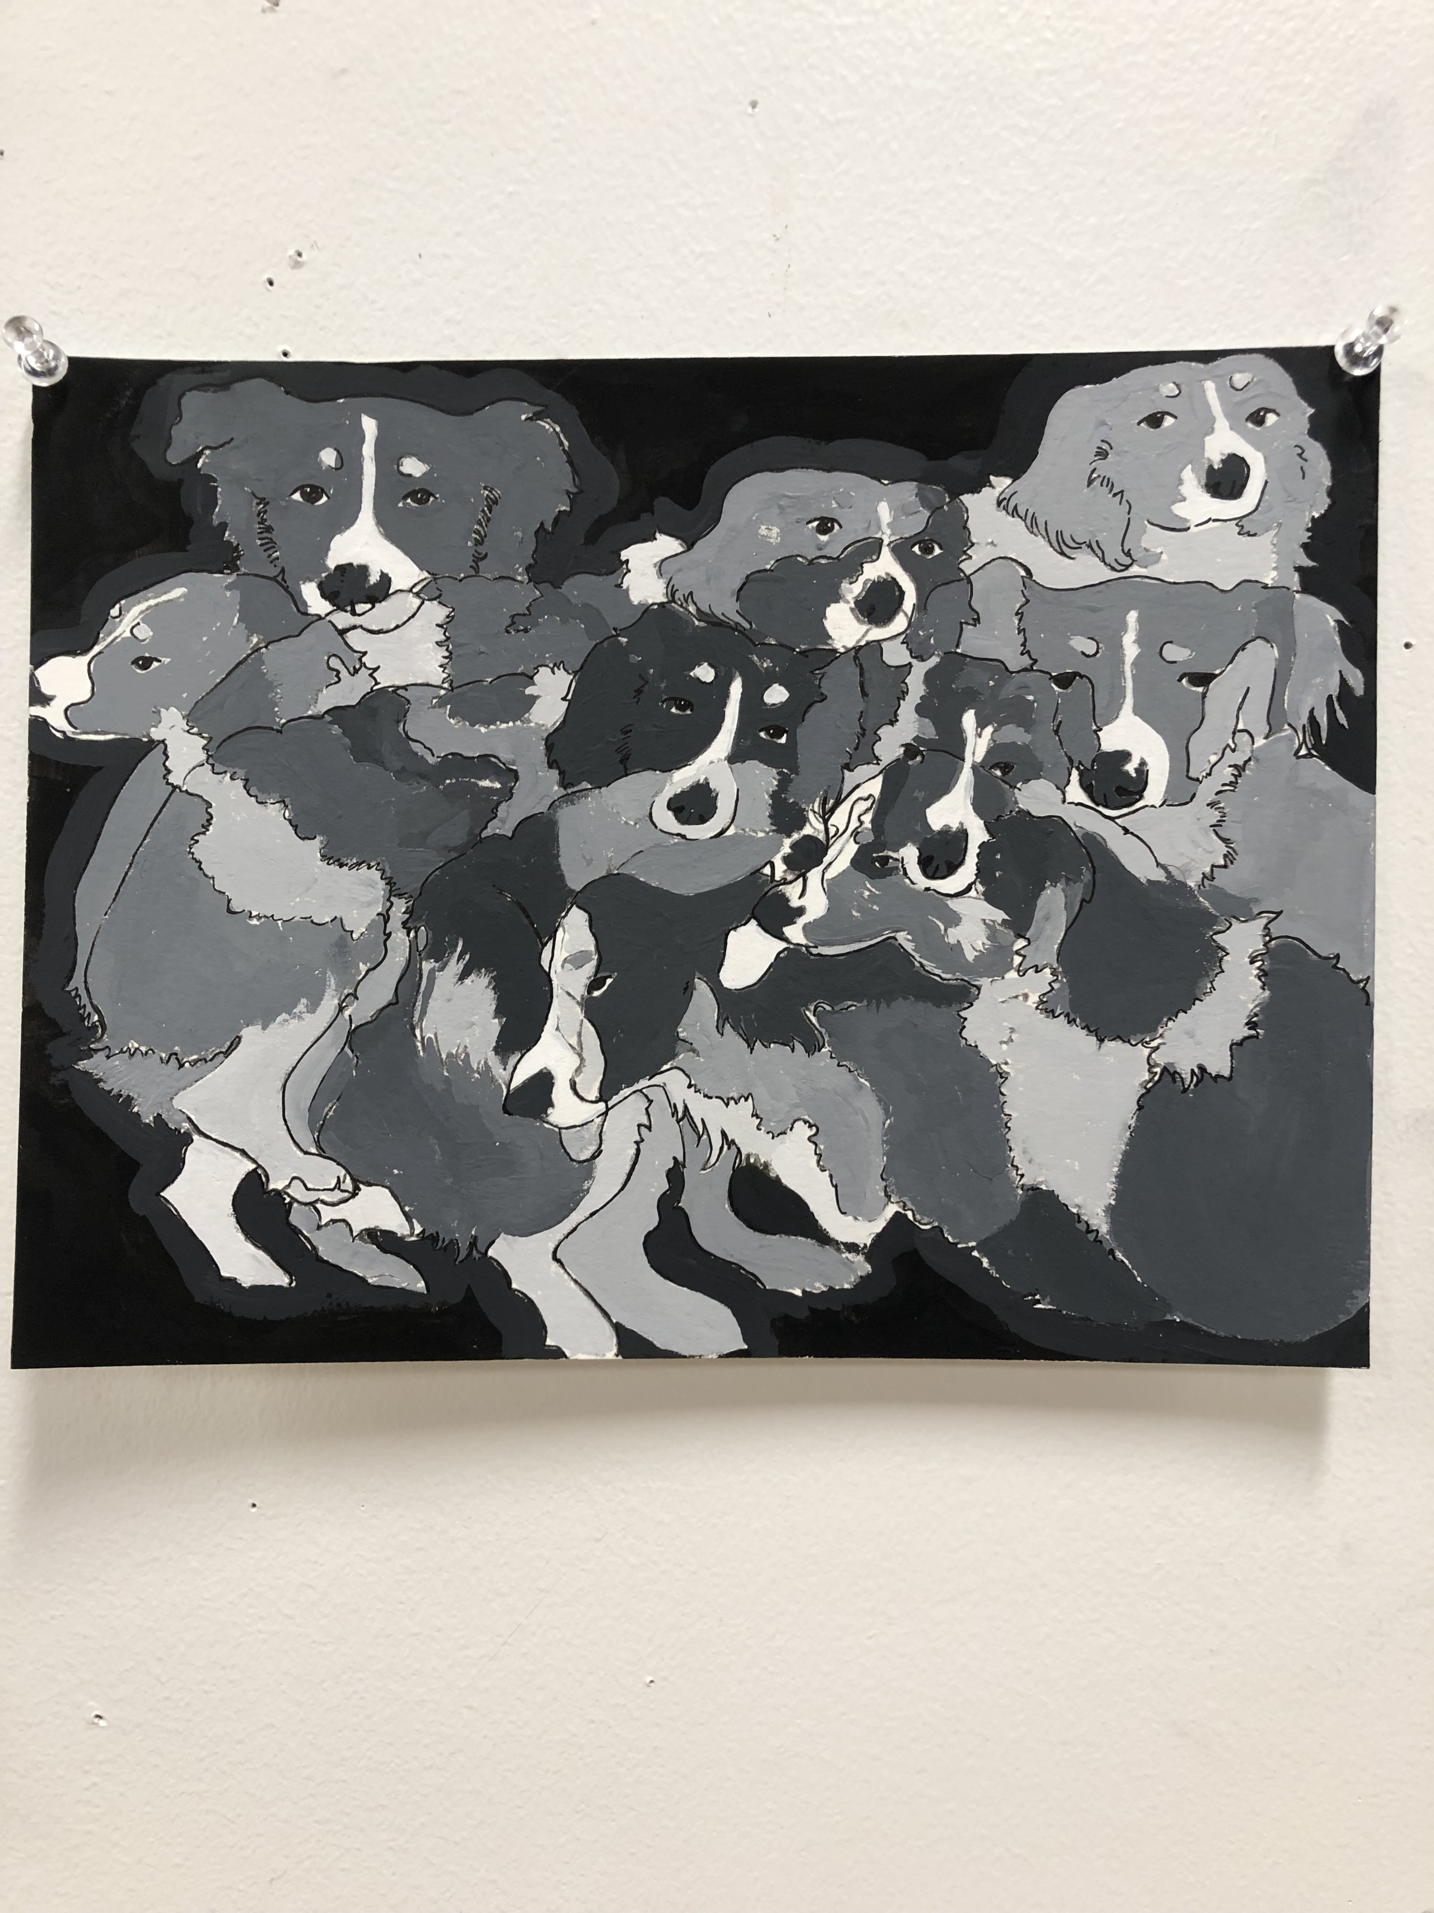

Slide 24
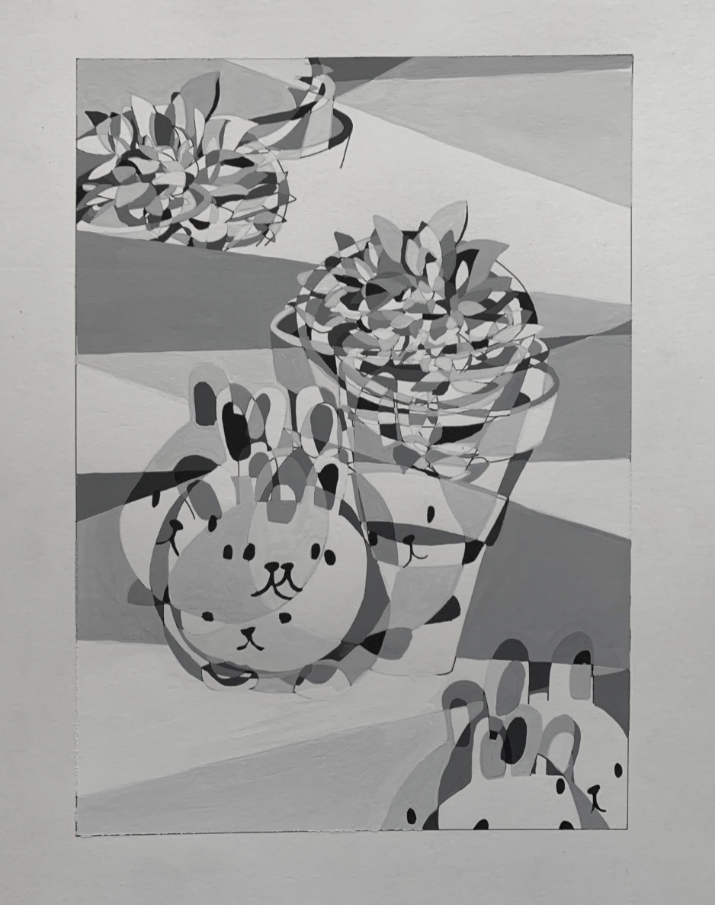

Slide 25
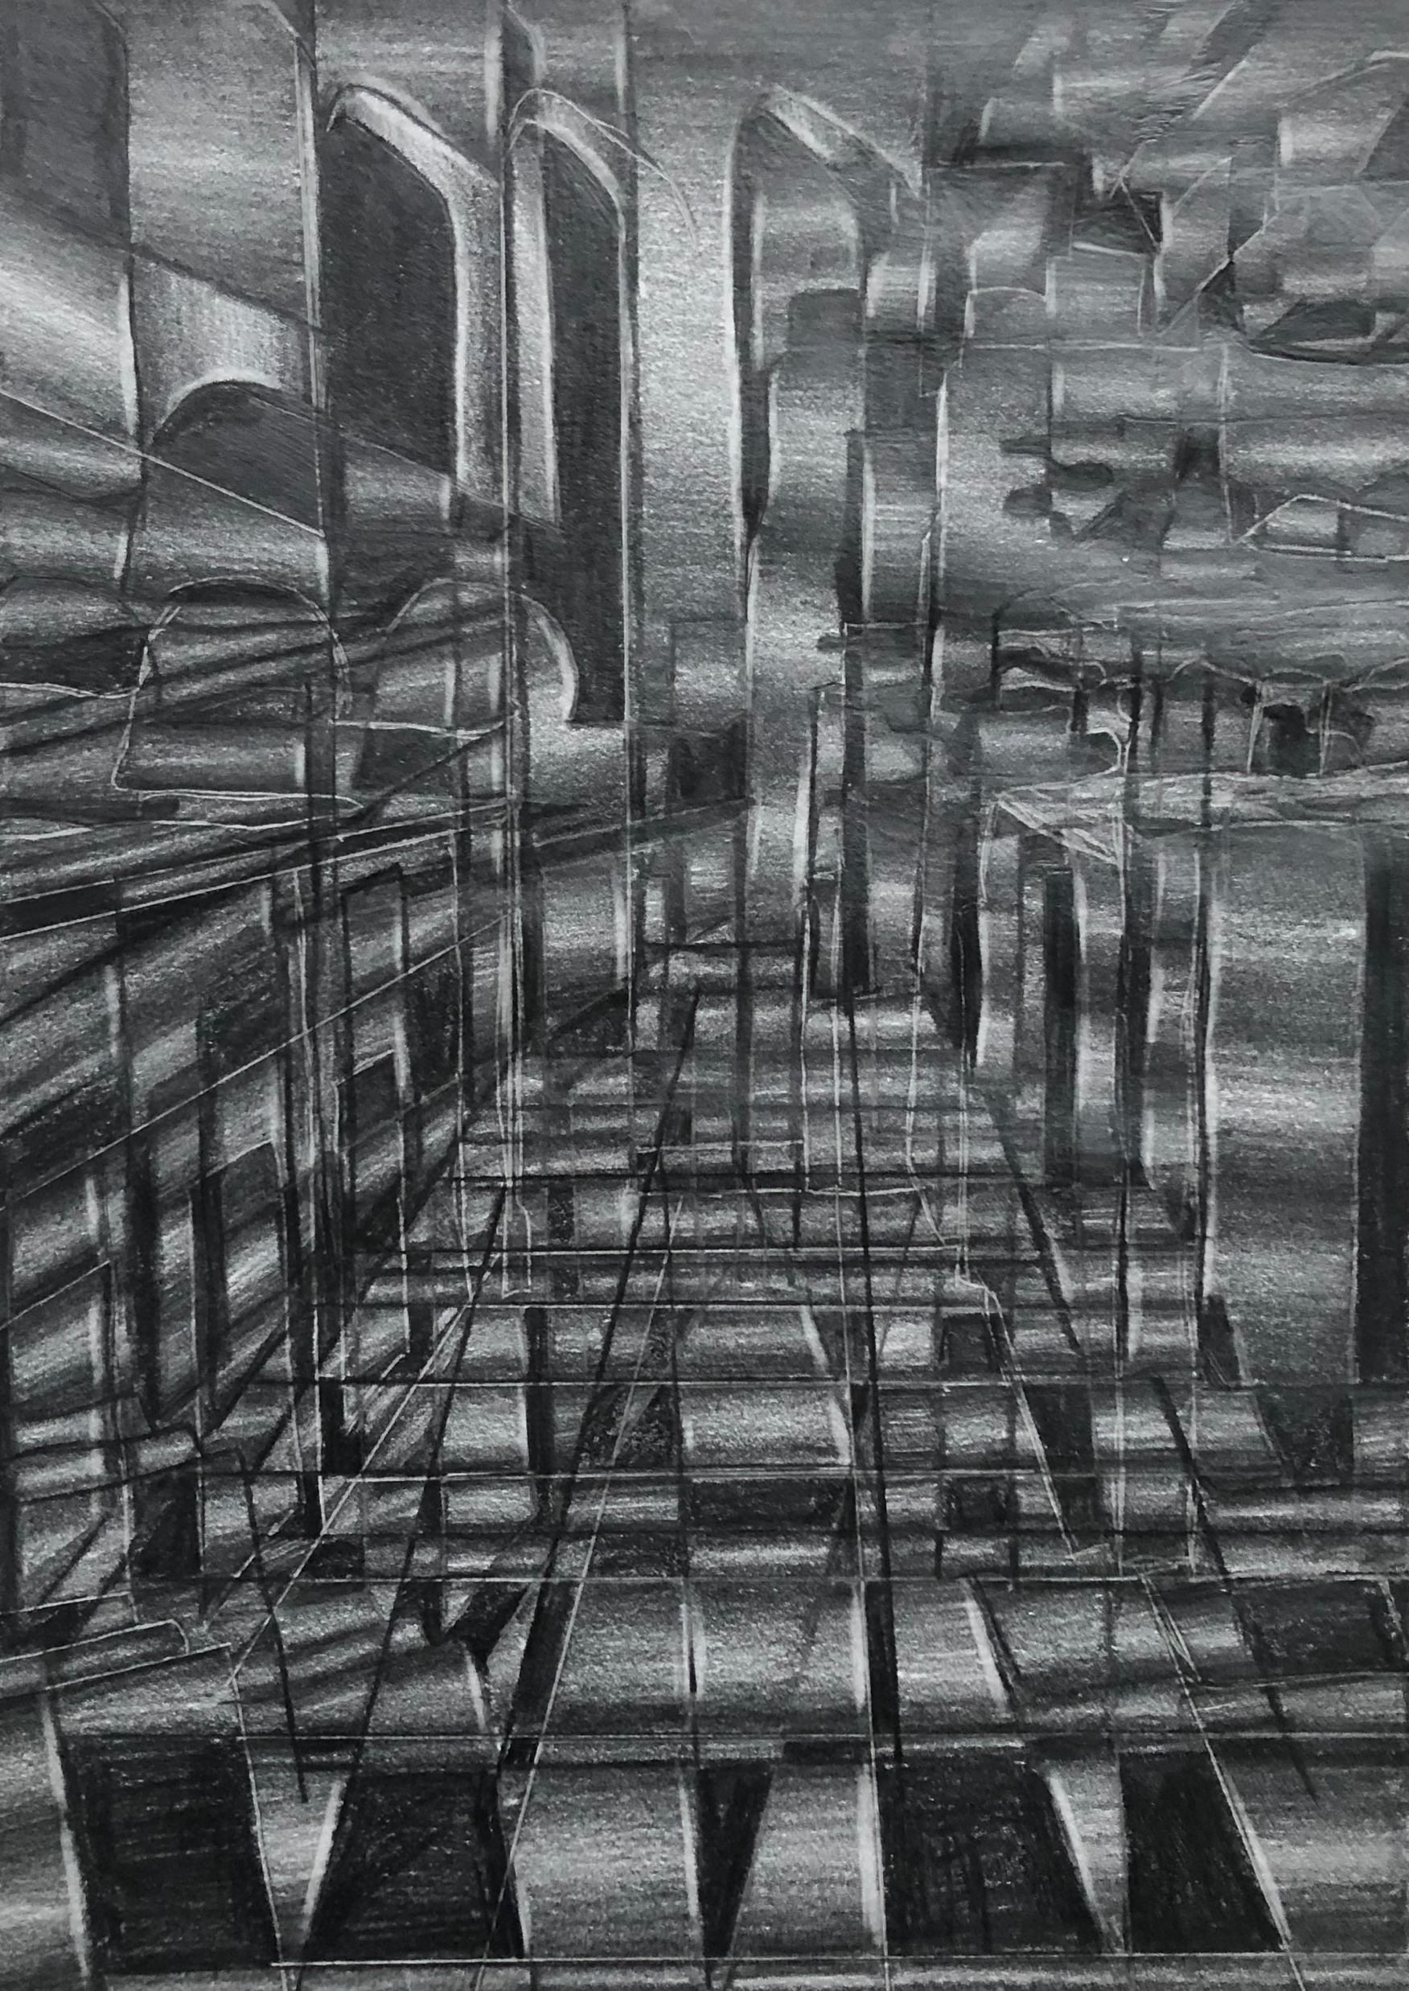

Slide 26
