Slide 1
Gestalt Principles
Figure/Ground
Completion
Proximity (Grouping)
Continuity
Ambiguity

Slide 2
Figure/Ground

Slide 3

Figure-Ground Designs

Slide 4
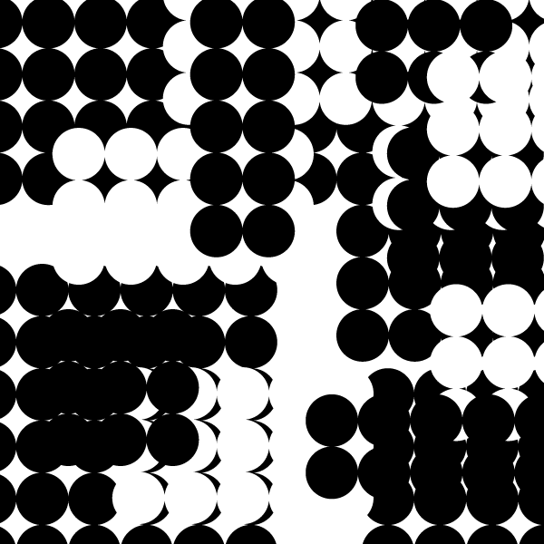
Figure-Ground Design Using Only Circles

Slide 5
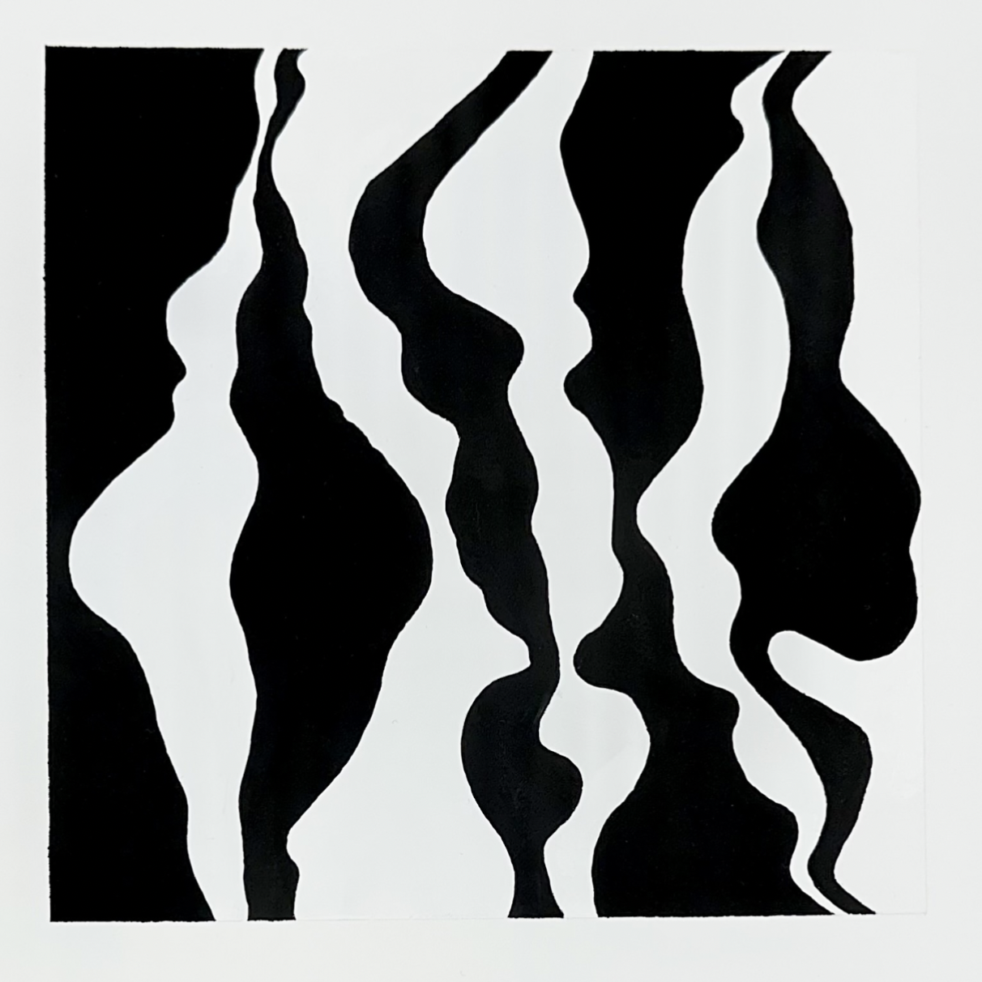

Slide 6
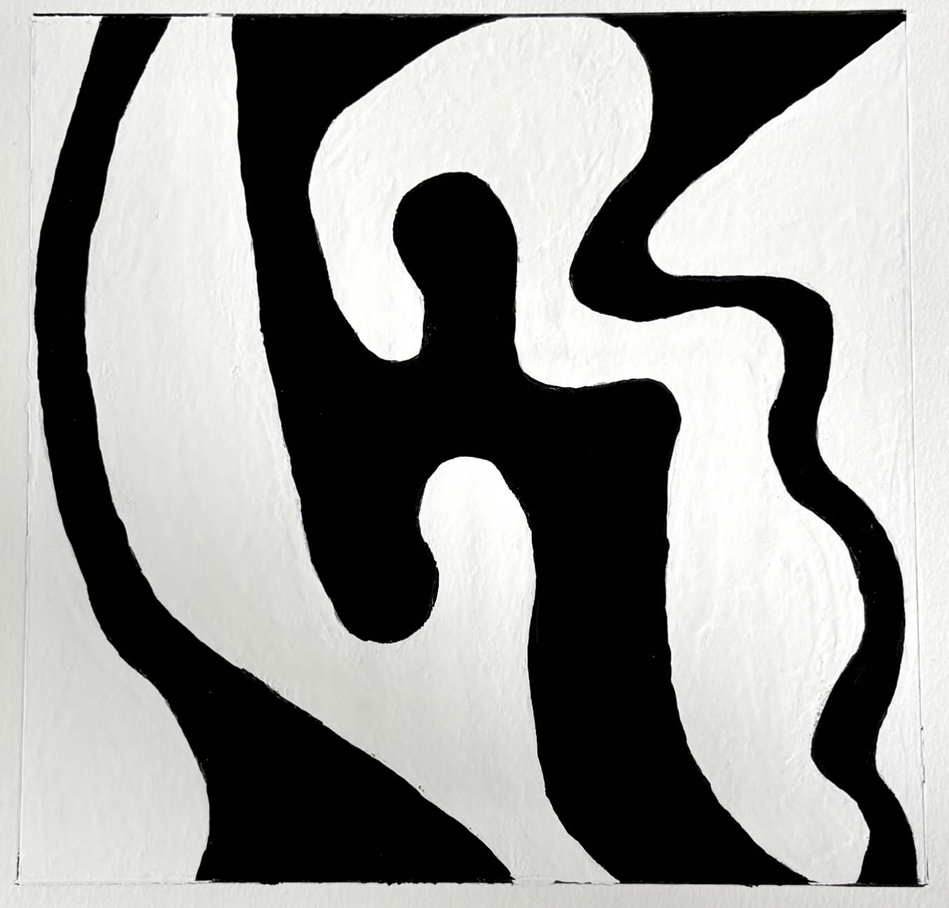

Slide 7
Completion

Slide 8
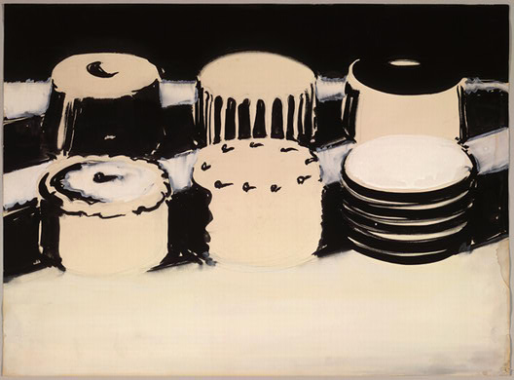
Thiebaud “Cake Study” 1963

Slide 9
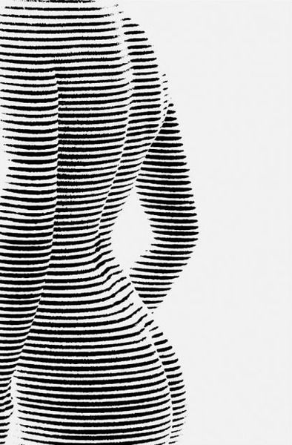

Slide 10


Slide 11


Slide 12
Grouping/Proximity

Slide 13
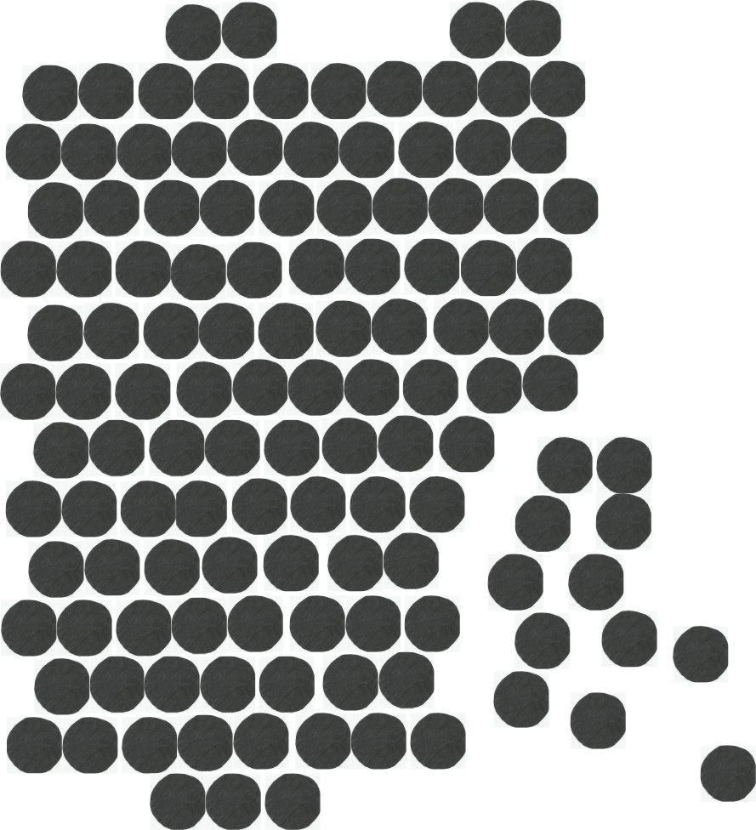
Rodchenko “Cropped”

Slide 14

Albers Design

Slide 15
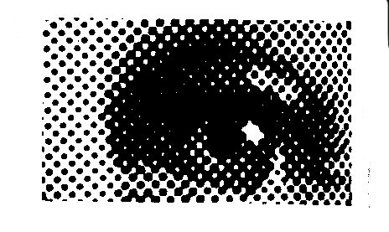

Slide 16
Continuity

Slide 17


Slide 18


Slide 19

Rodchenko “Cropped”

Slide 20
Ambiguity

Slide 21
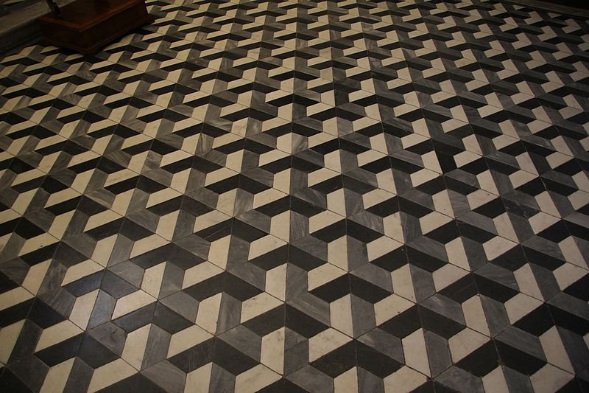

Slide 22


Slide 23
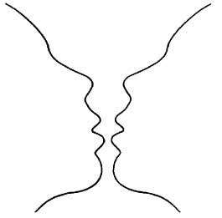

Slide 24

Rodchenko “Cropped”

