Slide 1
Figure-Ground Reversal and The Gestalt

Slide 2
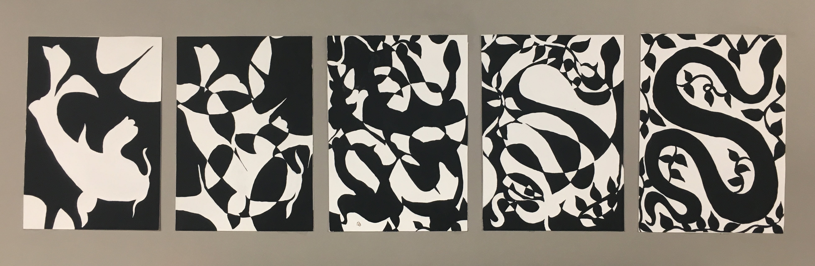
Figure-Ground Reversal

Slide 3
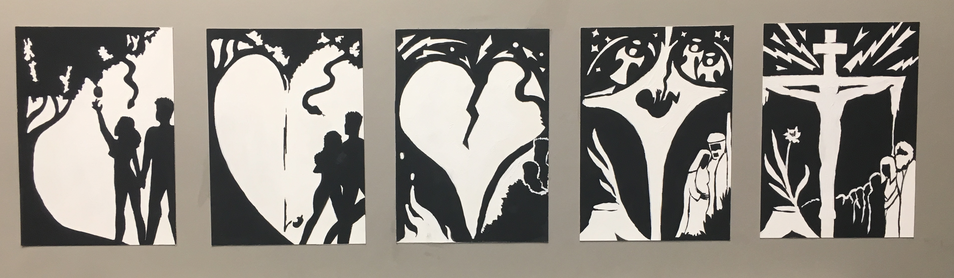
Figure-Ground Reversal

Slide 4
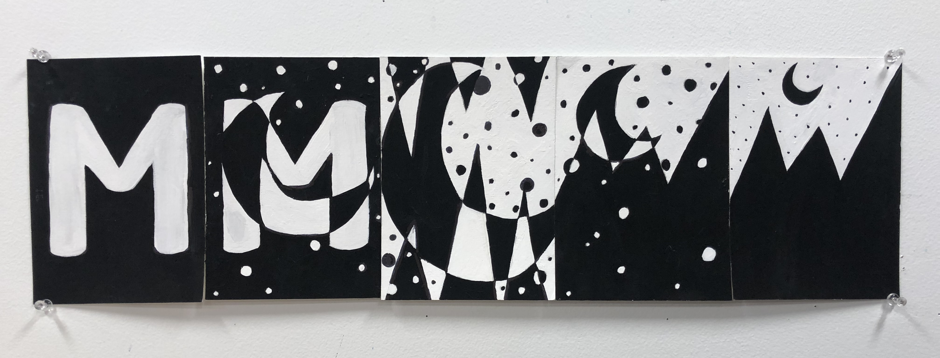
Figure-Ground Reversal

Slide 5
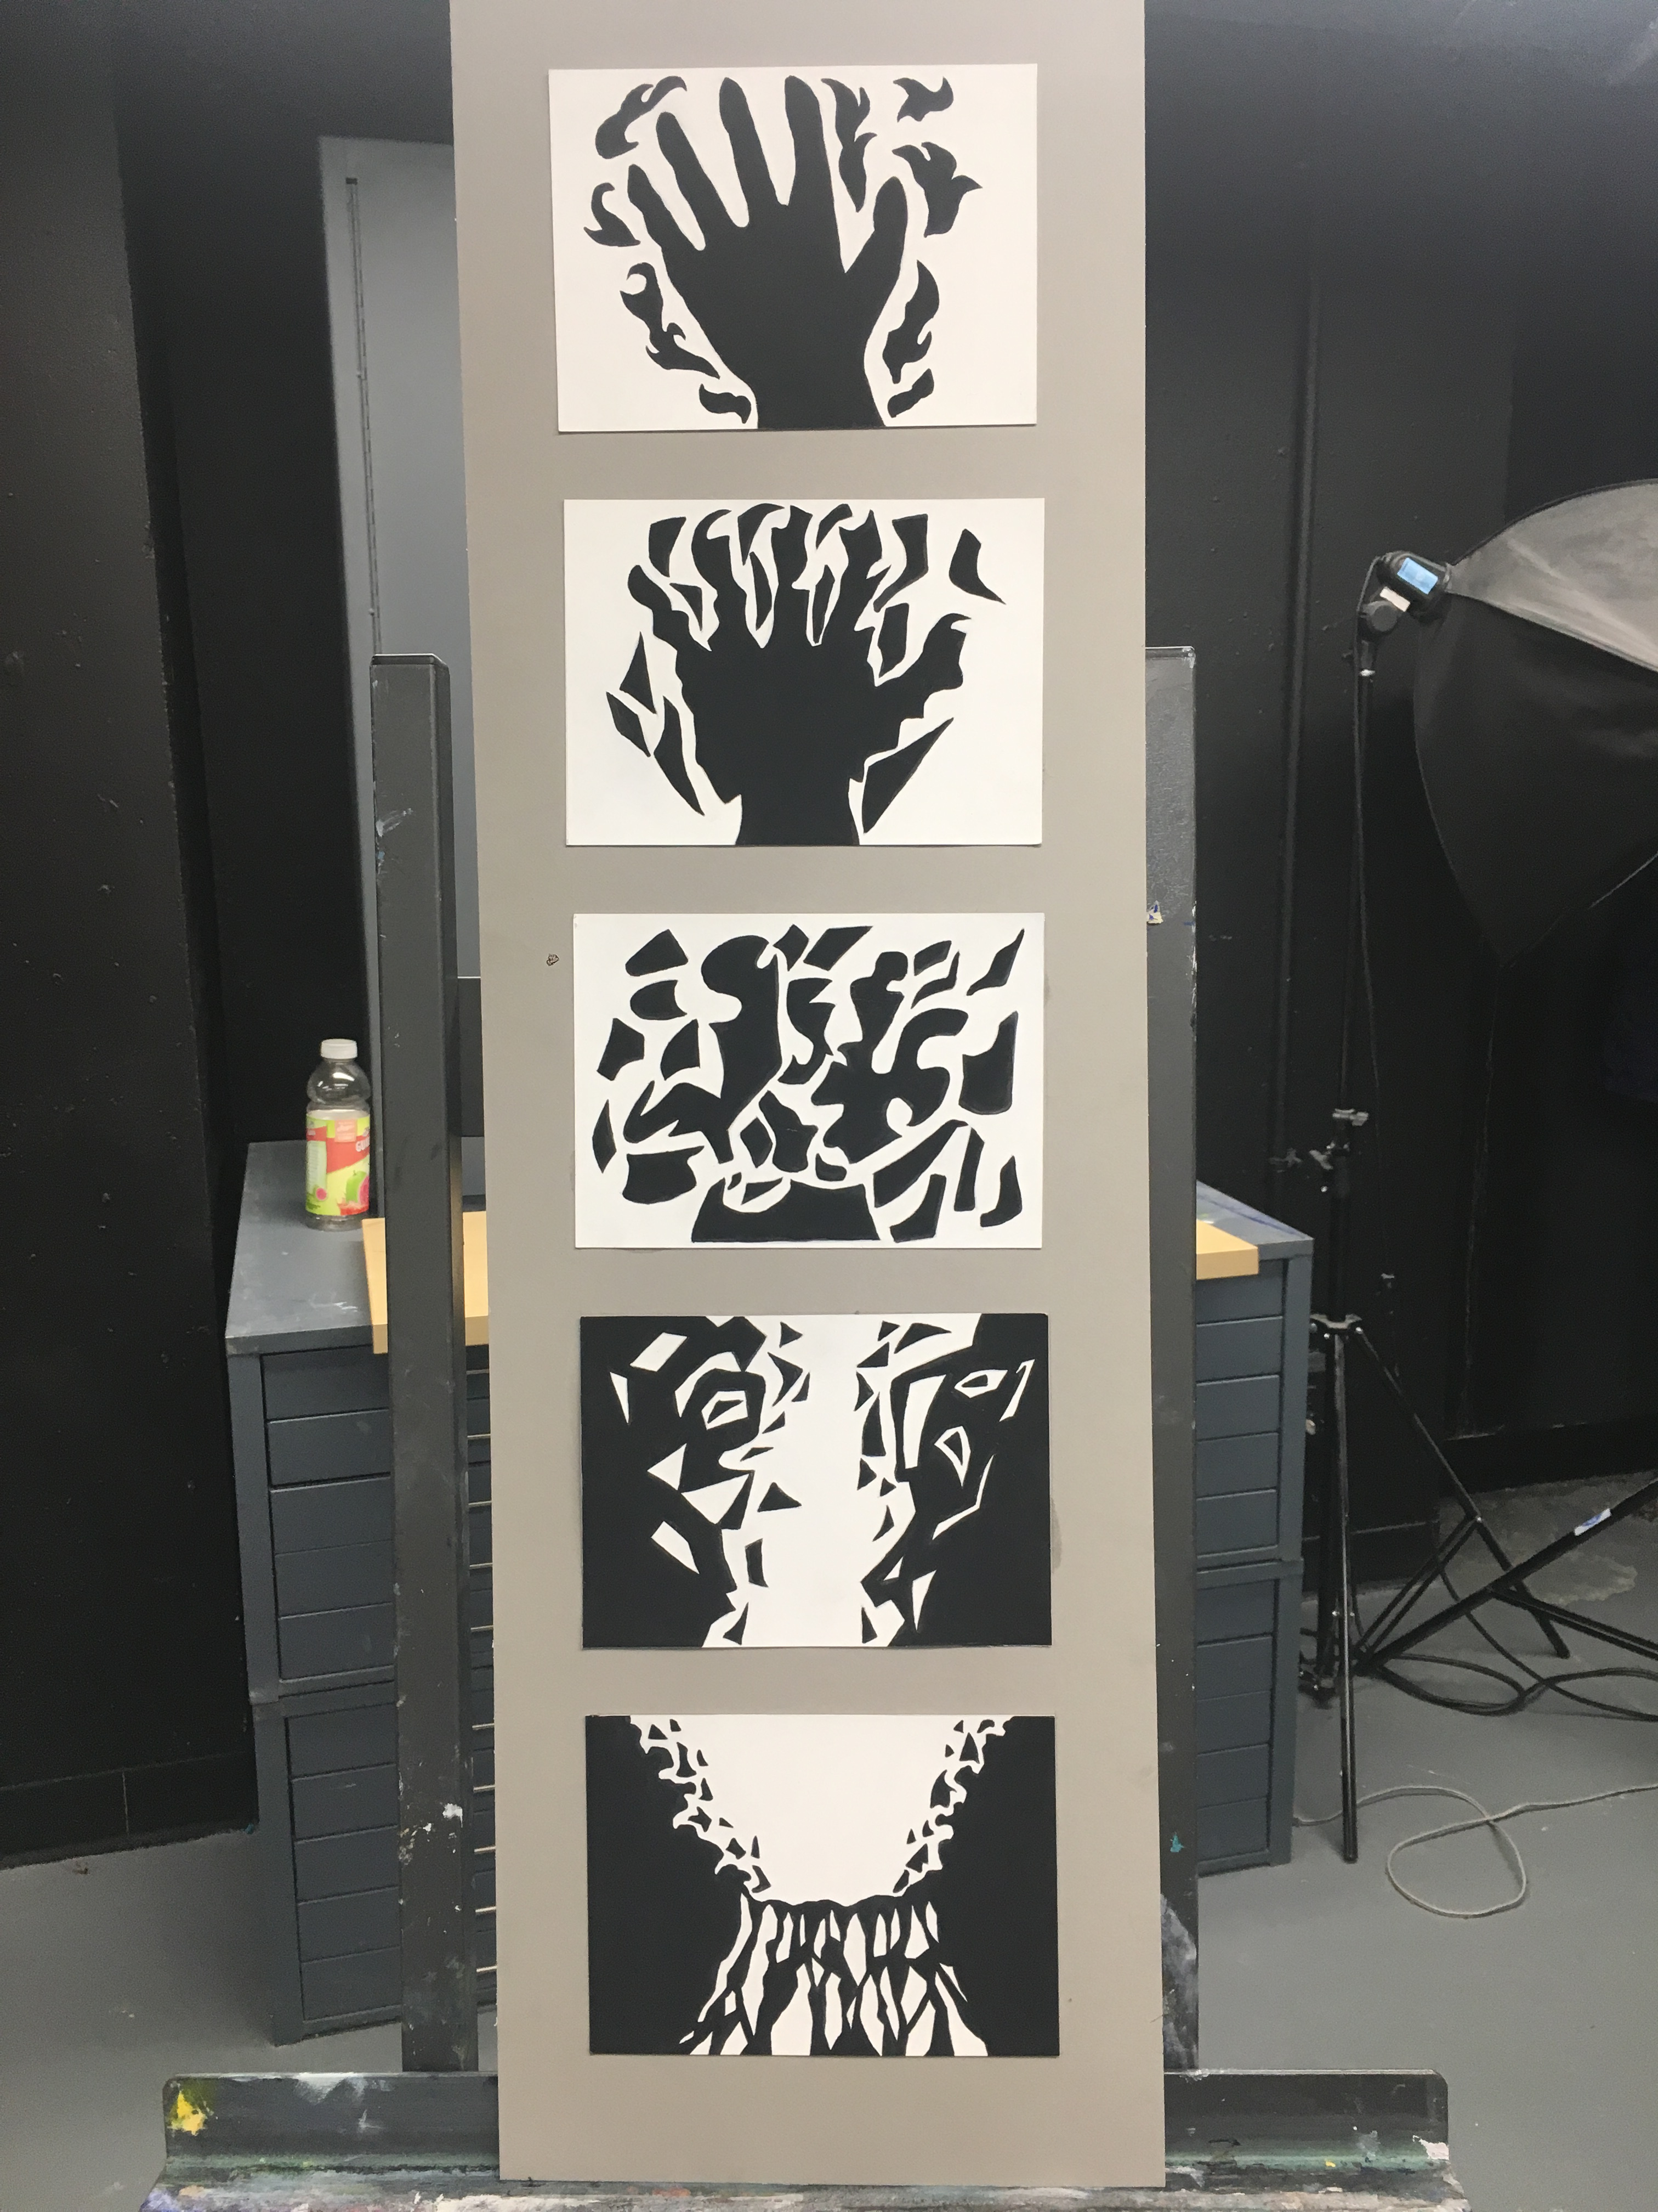
Figure-Ground Reversal

Slide 6
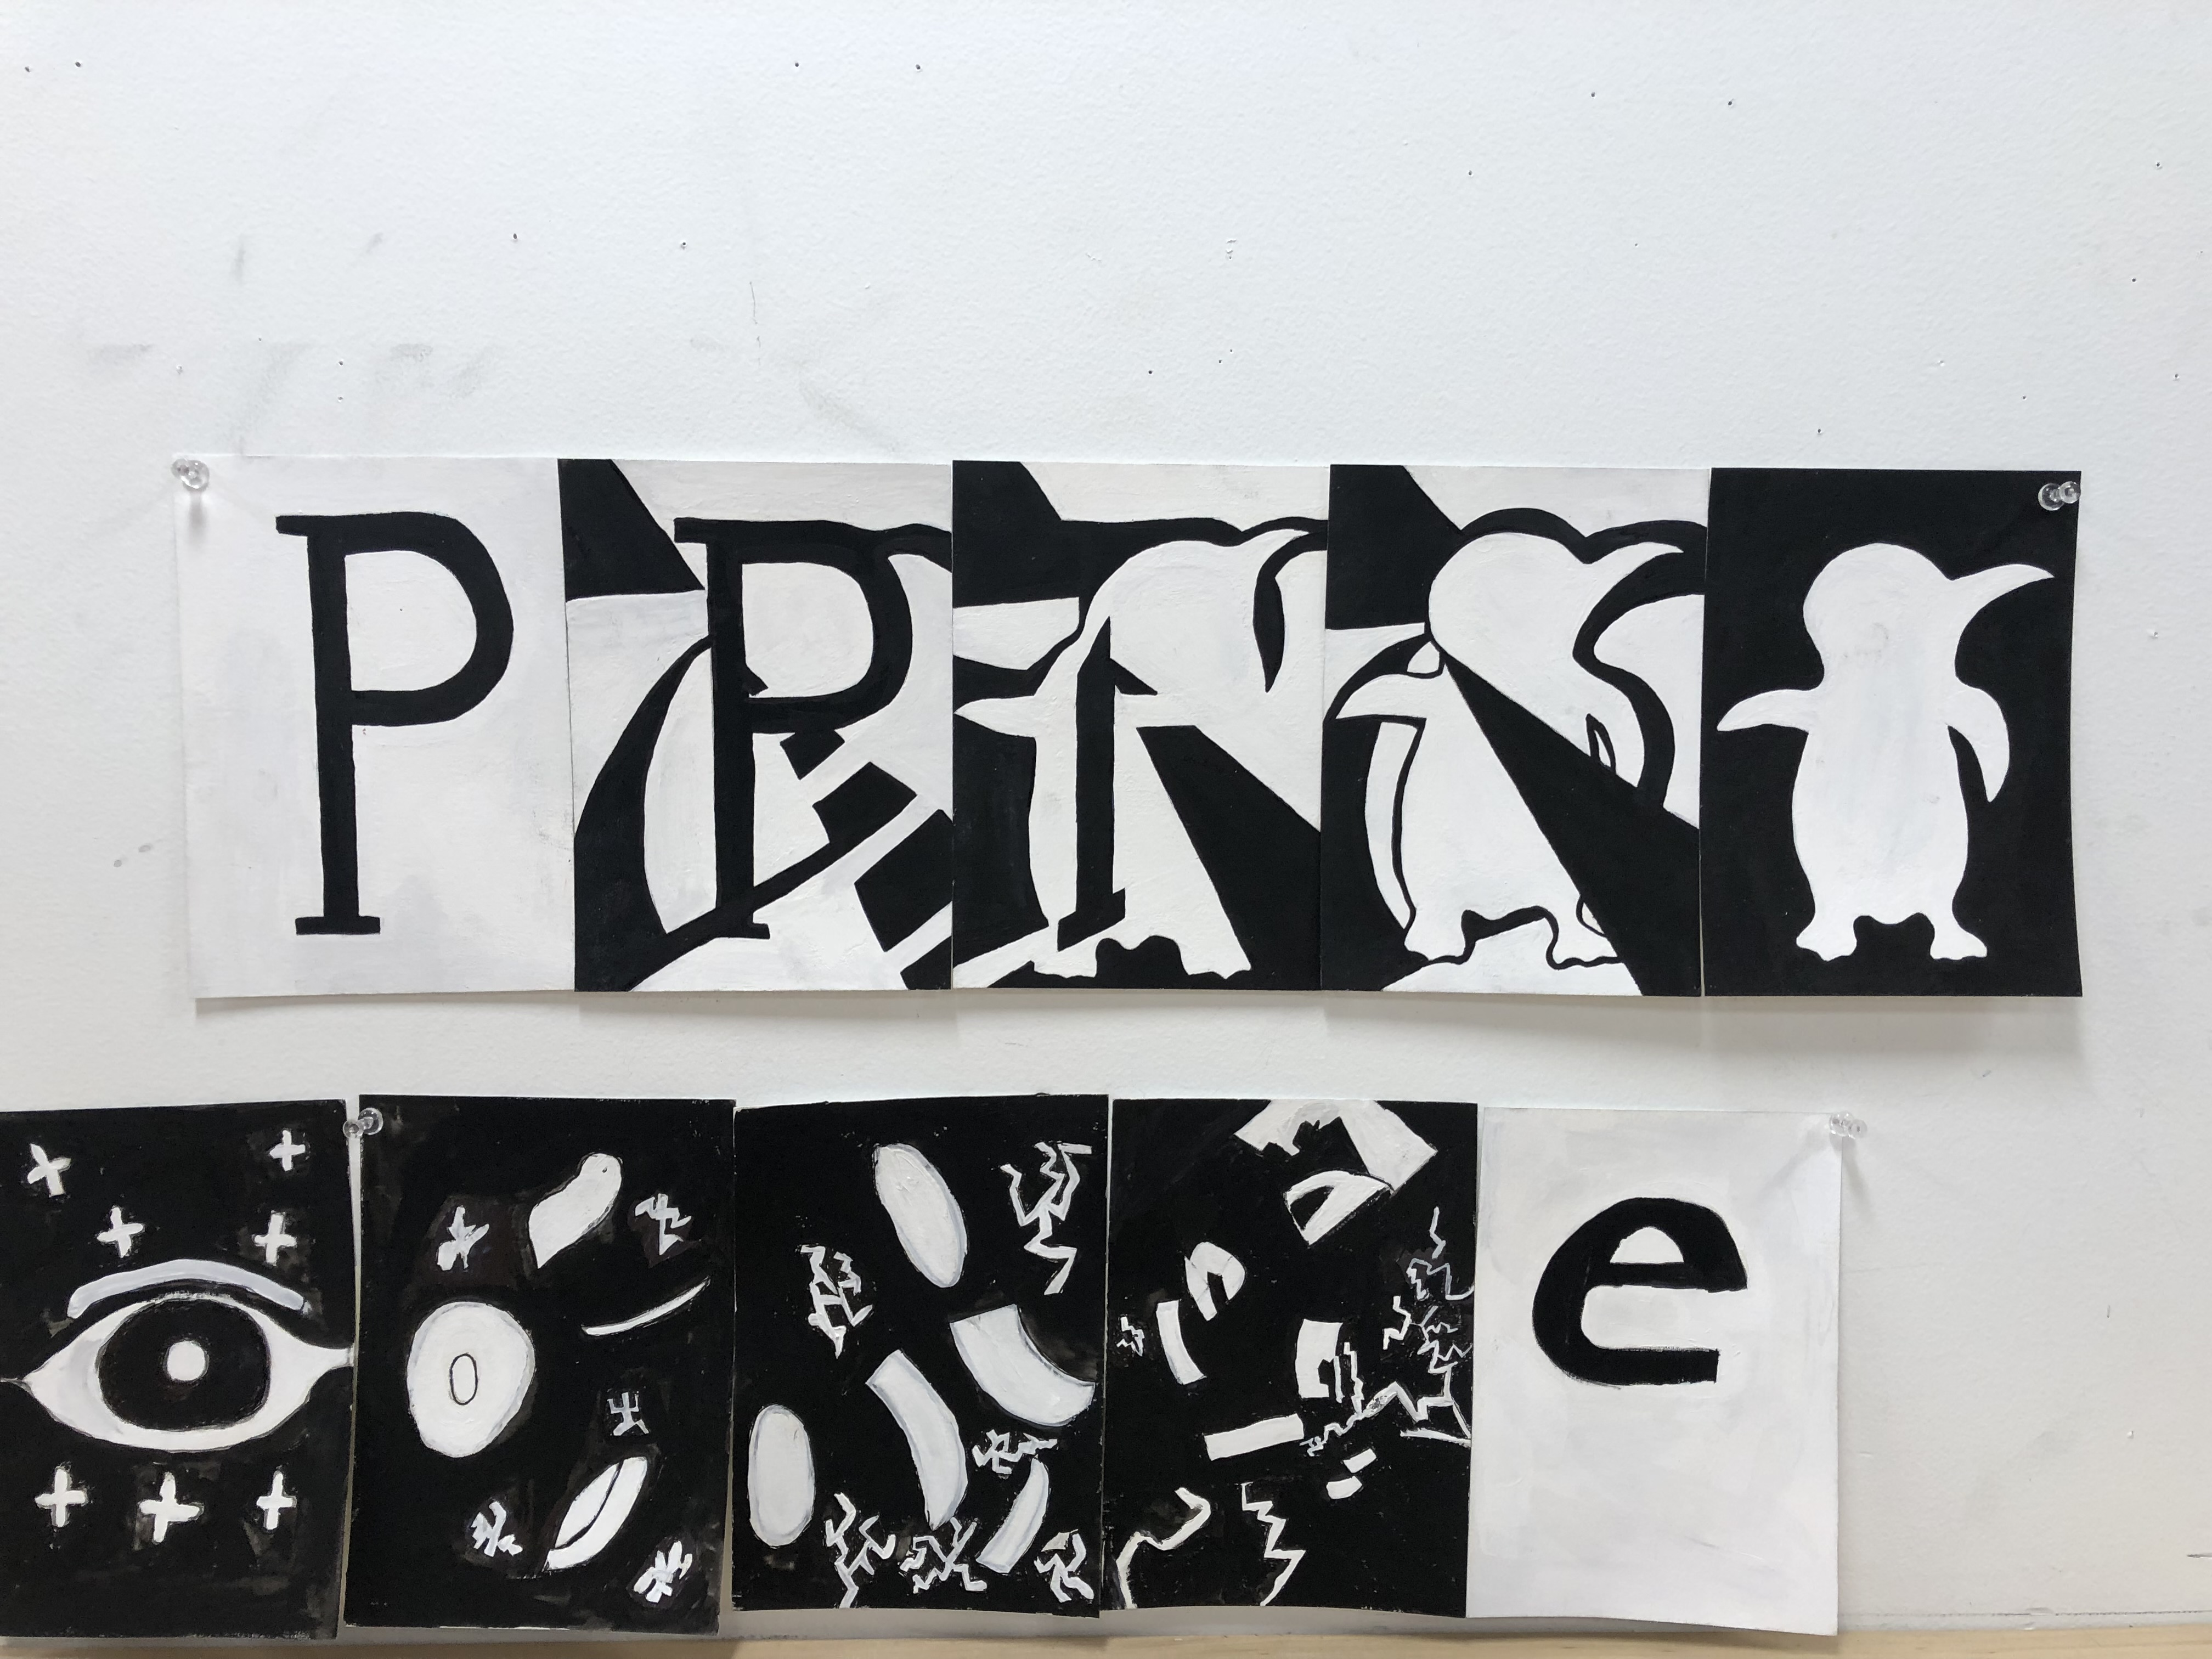
Figure-Ground Reversal

Slide 7
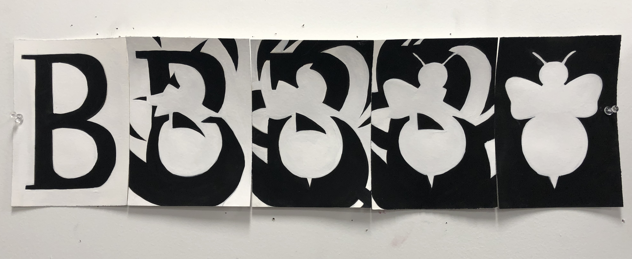
Figure-Ground Reversal

Slide 8
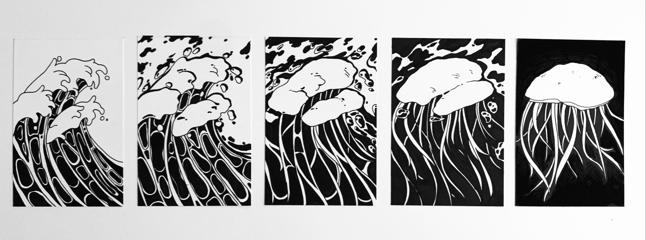
Figure-Ground Reversal

Slide 9
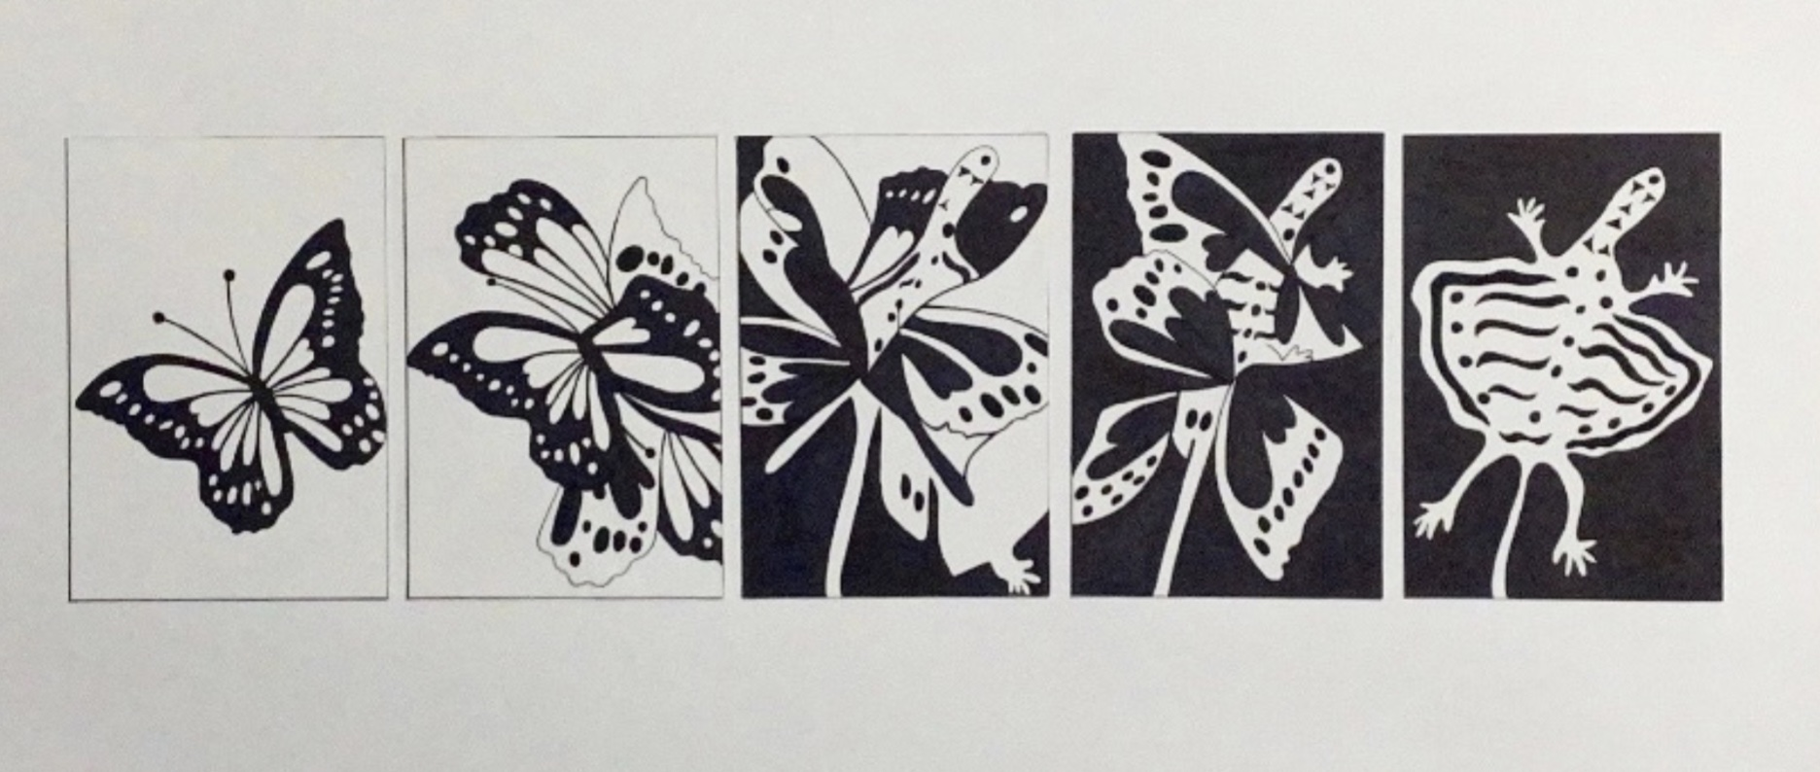

Slide 10
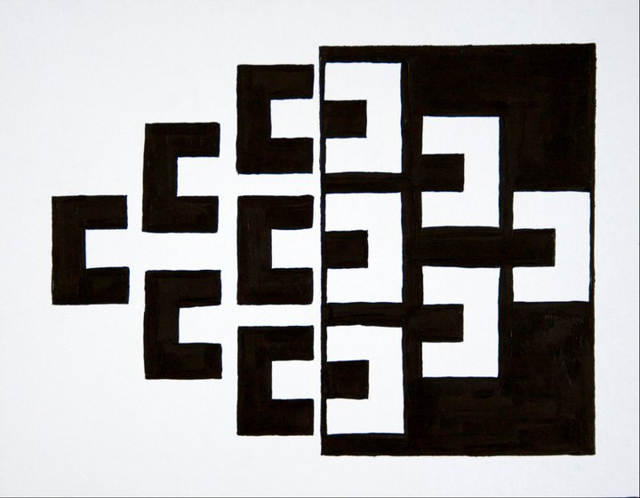
Figure-Ground Design

Slide 11

Figure-Ground Reversal

Slide 12

Figure-Ground Reversal

Slide 13
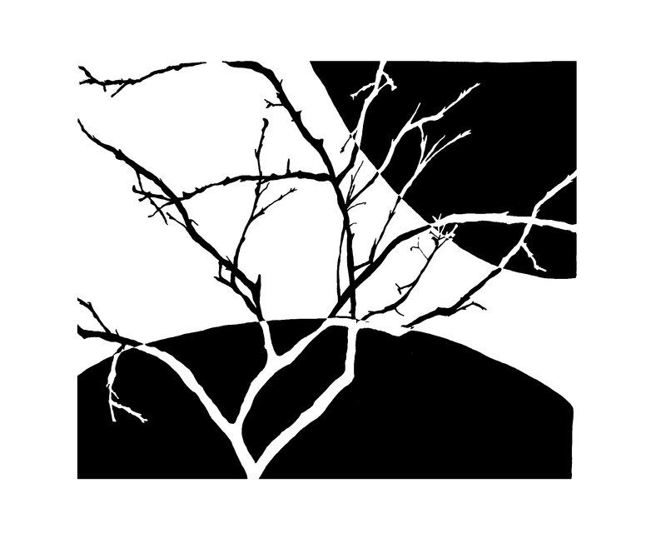
Figure-Ground Design

Slide 14

Figure-Ground Reversal

Slide 15
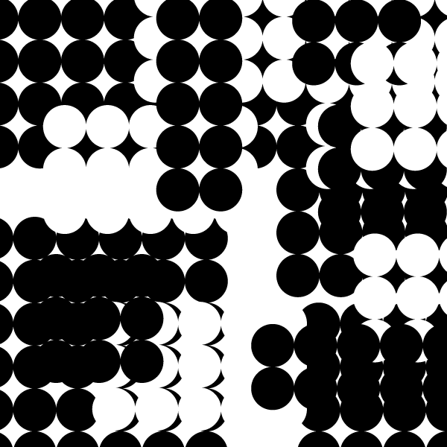
Figure-Ground Design Using Only Circles

Slide 16
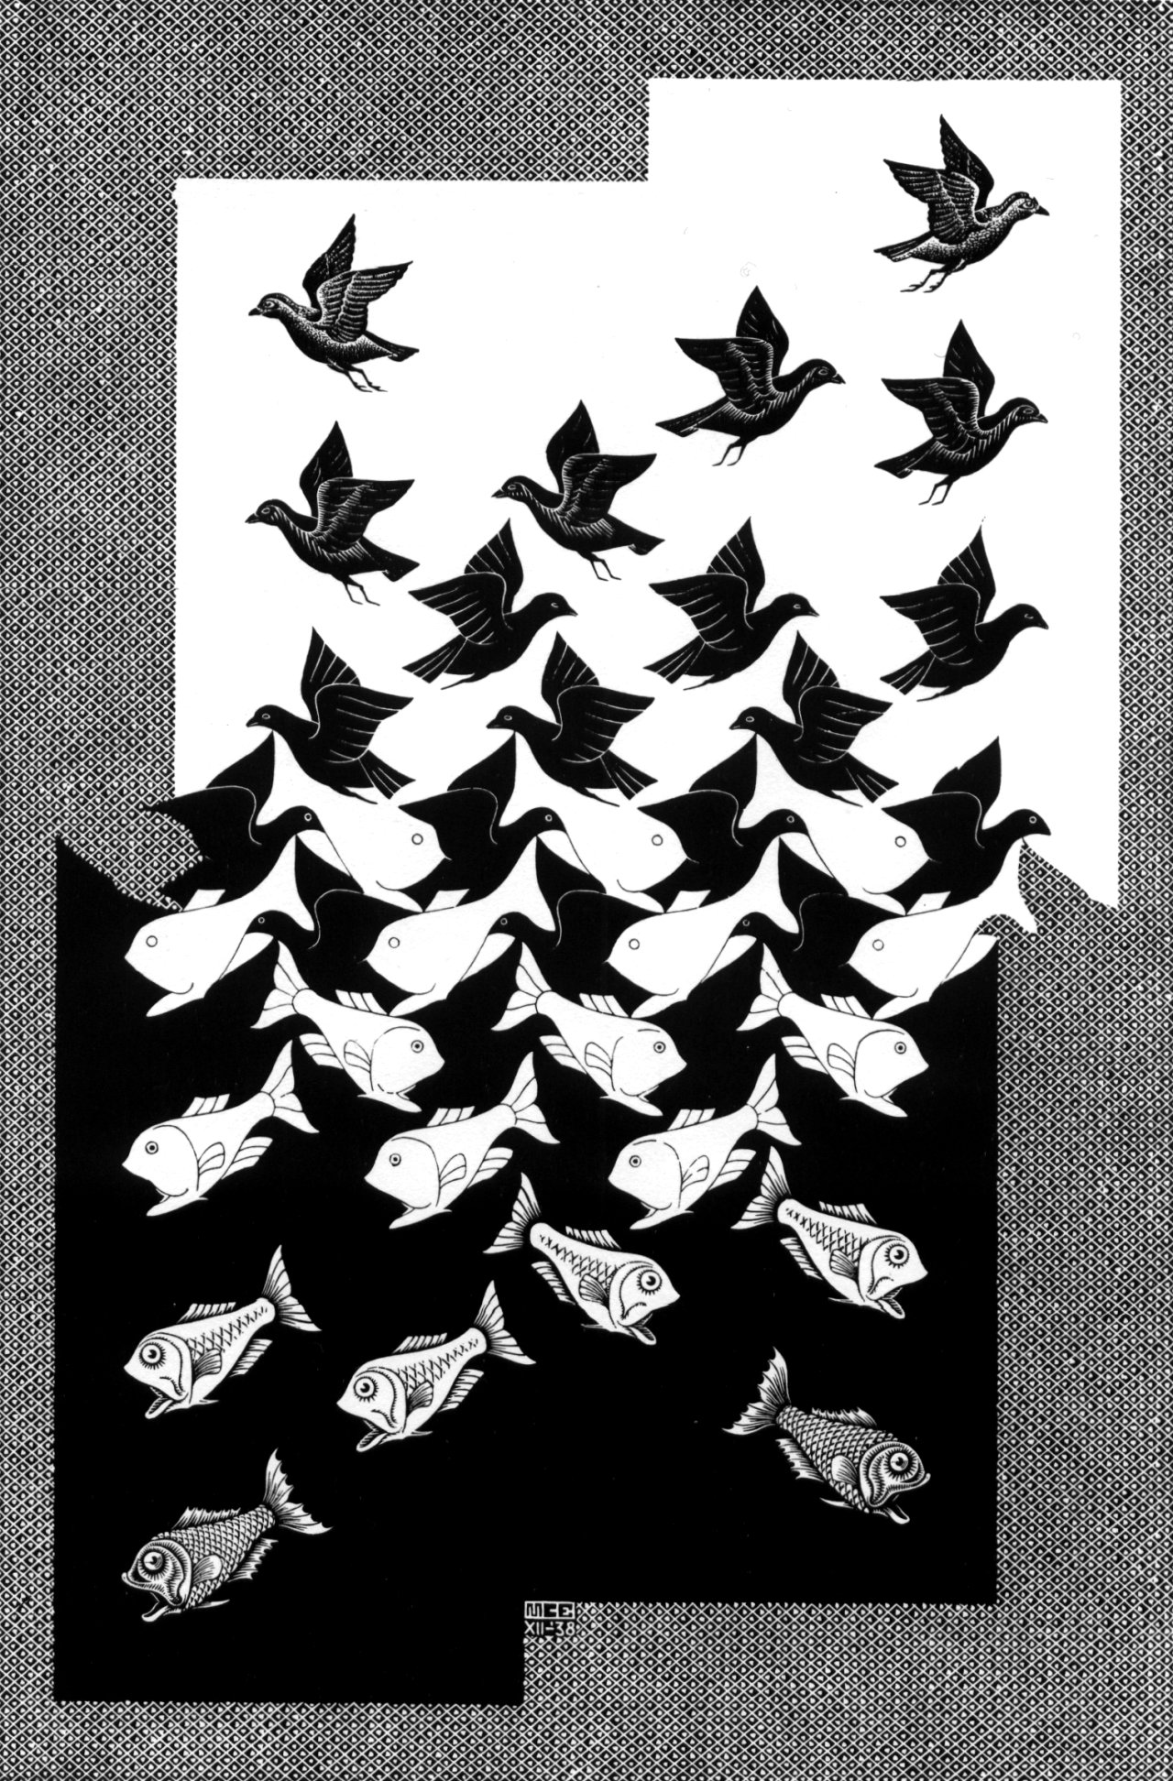
Figure-Ground Design

Slide 17
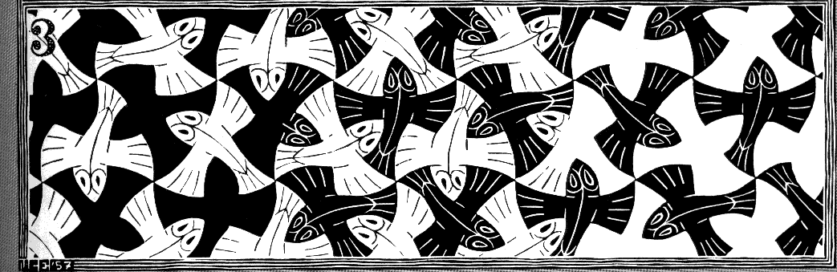
Figure-Ground Reversal

Slide 18

Figure-Ground Reversal

Slide 19
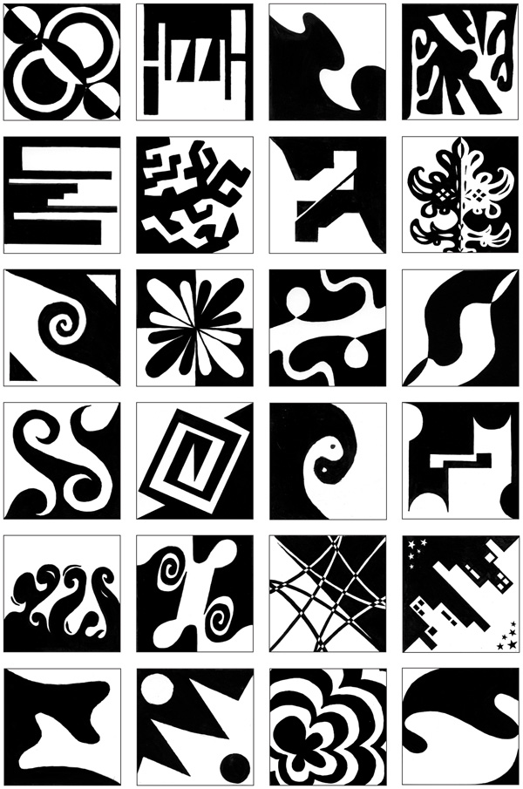
Figure-Ground Designs

